Slide 1
School is Easy
HOW We Do What We Do
Product Knowledge

Slide 2
HOW we do what we do
Main Topics
Product Knowledge (as part of our Foundation / our Brand)
Unique Selling / Value Proposition
School is Easy & Tutoring Process
Homework App
Assessments
Learning Style
Learning Loss
Academic Foundation

Slide 3
HOW we do what we do
School is Easy Unique Selling Proposition (USP)
At School is Easy, we personalize learning
At School is Easy, we are here to meet our students’ needs & goals
At School is Easy, we work together to make a difference
At School is Easy, we embrace diversity

Slide 4
HOW we do what we do
School is Easy Process (5M’s)
Meet: with parent (& child) and conduct a Learning Consultation (LC) and assessment
Make a plan: during LC you evaluate the child’s needs and goals. Based on your findings, you make a plan to help child reach defined goals.
Match: We match your child with a tutor that is the best suited for his/her academic needs, personality and learning style.
Monitor: Session Logs are emailed to parent after every session. Session Logs allow you and the parent monitor the child’s progress at every stage.
Modify: As you get to know the child, or as things change, you will suggest modifications to the plan to better address the child’s needs and goals.

Slide 5
HOW we do what we do
School is Easy Tutoring Process (4C’s)
Commitment – from both sides, parent/child commit to the process, to the schedule and to doing the work (child) – SIE commits to doing what we say we’re going do and show up when we say we’re going to show up.
Collaboration -Parents know their child best, their personality, their likes and dislikes, behavoiurs, etc. and the Child can tell us from his/her perspective what’s happening at school and Teachers can provide insight into current progress child is making at school. Armed with these insights SIE has a more complete picture and understanding of the situation and can design a more well rounded plan and approach to helping your child with the struggles he/she is having at school.
Communication - On going communication between all stakeholders to ensure we are making progress on the tutoring plan (monitor and modify as outlined in SIE process)
Consistency - Consistency of schedule. A session here and a session there is not going to solve anything. SIE is not a “homework” machine. (consistent practice makes perfect)
Notes:
Goal and Purpose – How do we talk to these points with the parent.
commitment, collaboration, communication, consistency.
Together they create a successful tutoring relationship
commitment,
It’s a two way street:
Parent and Child: A commitment to the schedule and showing up.
parent to ensure that their children are showing up for tutoring every week, it can't be Oh, this week, we've got a birthday party. Oh, next week, we're going to Hawaii Oh, we just don't feel up to it this week.
If we're going make a difference, the child actually has to show up. So commitment is huge.
Commitment from SIE and our Tutors to do what we say we are going to do and show up when we say we are going to show up.
collaboration (& customization), (it’s not one size tutoring fits all and SIE tutoring cannot be successful in a vacuum – it’s about collaboration with those who know the child best)
To assist with helping the child achieve the desired outcomes, SIE will work in collaboration with the parent and given permission, current teachers of the child. At SIE we do not have a magic wand to make everything right again and we cannot work in isolation.
Parents know their child best, their personality, their likes and dislikes, behavoiurs etc etc and
the Child can tell us from his/her perspective what’s happening at school and
Techers can provide insight into current progress child is making at school.
Armed with these insights we have a more complete picture and understanding of the situation, As a result, SIE can form a more well rounded plan and approach to helping your child with the struggles he/she is having at school.
communication
On going communication between all stakeholders to ensure we are making progress on the tutoring plan (monitor and modify as outlined in SIE process)
consistency
Consistency of schedule. A session here and a session there is not going to solve anything. SIE is not a “homework” machine.
To truly make a difference think of tutoring like a learning the piano or being good at sport – hockey let’s say.
For someone to be get really good , he /she needs to practice, practice, practice and practice again. To put on skates and play once in a while, nothing wrong with that unless every time you step o the ice, you fall down. In that case you will want to skate more often, maybe make it a routine until you find you are now able to stay upright.

Slide 6
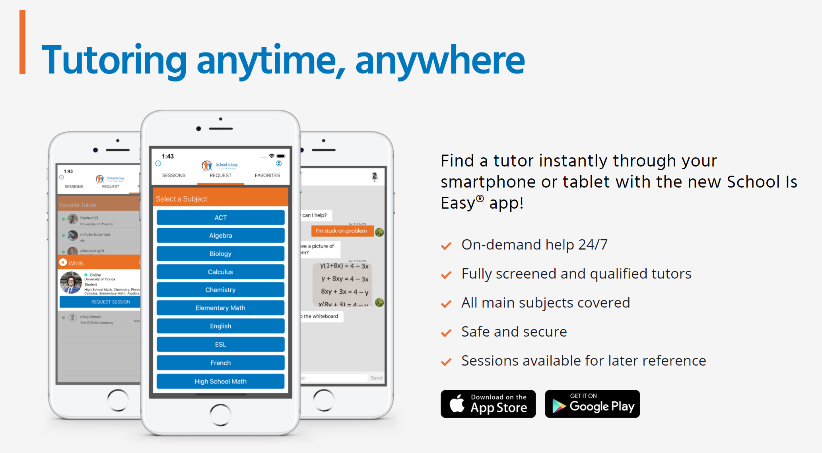
HOW we do what we do
School is Easy Homework App.

Slide 7
HOW we do what we do
School is Easy Homework App.
Write down the main points you highlight to tutors, friends and others when telling them about the School is Easy Homework App.

Slide 8
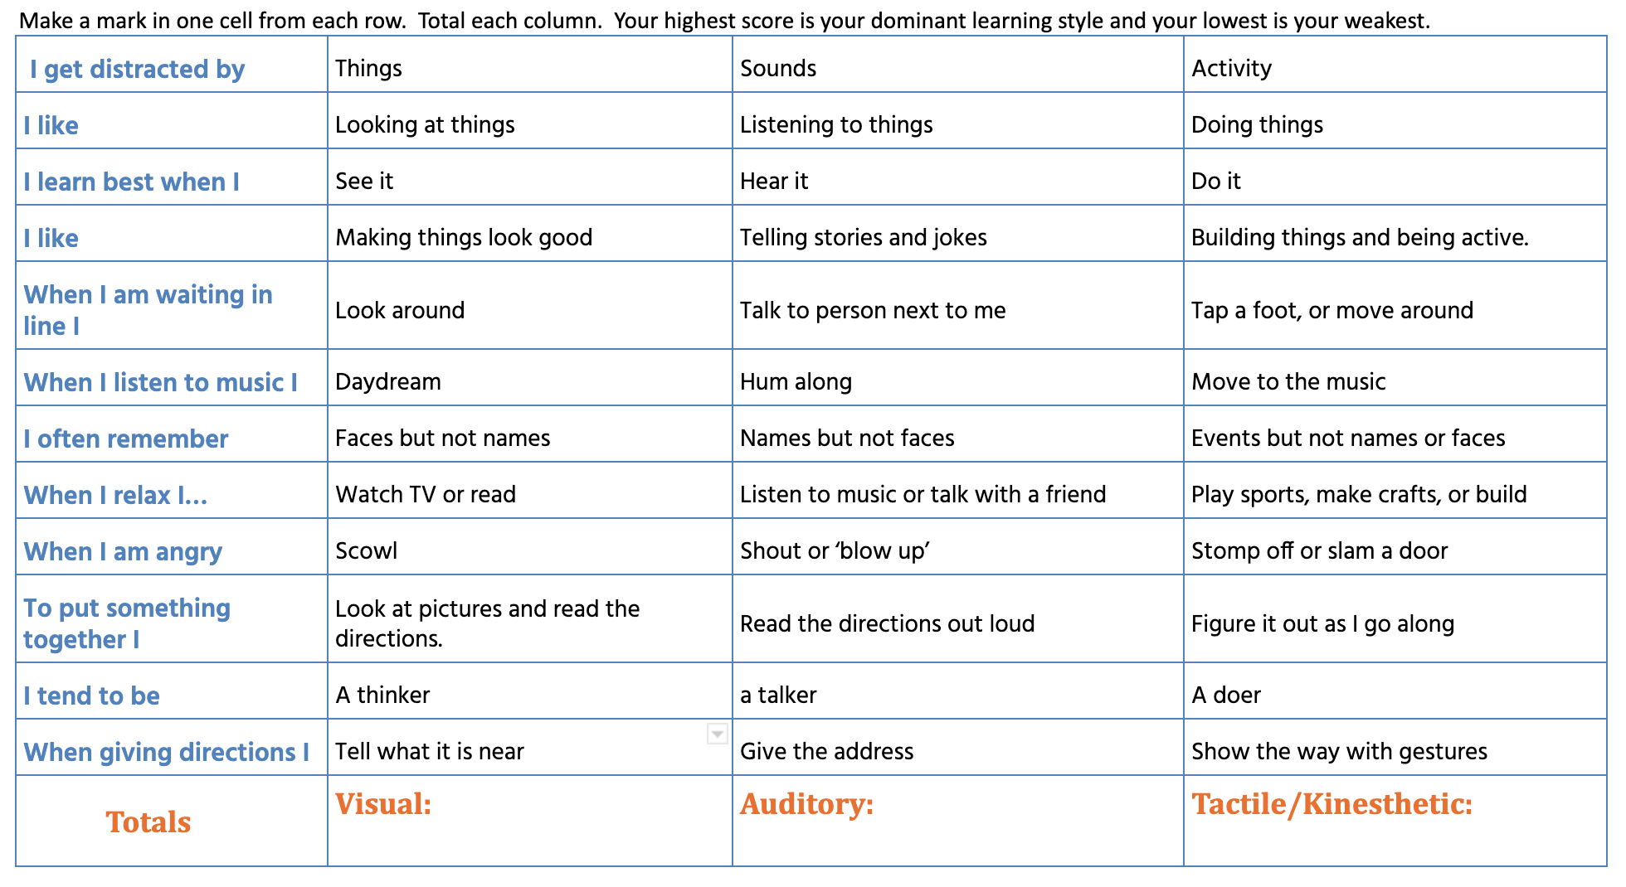
HOW we do what we do
School is Easy – Identifying Learning Styles
Notes:
Learning Styles
Do you or do you know how to use this tool during a conversation with the parent or student?
Notes:
somebody who is a tactile / kinesthetic learner learns best by doing.
-the tutor is not only going to have to demonstrate how to solve something, but the mastery will come for <child’s name(s)> in doing it in the practice. So practice by doing is going to be important.
auditory, on the other hand would have the tutor giving <child name> different explanations, and talking about it.
- Speaking and explaining would be helpful to his/her learning.
Visual students may be motivated by puzzles, writing, crafts and movement. We may want to integrate such things as , videos, flashcards, post it notes, graphs and using visual cues from real life situations (maps, photos, menus etc ) to assist with their
This slide speaks to and demonstrates how our tutors can be ‘focused, and providing one on one attention to their students and how /he/she learns best.” We use this form with the Parent and or Child to determine child’s learning style. We then communicate what that style is to the tutor so he/she can best support learning to identified learning style. ”Customized learning”
We explain to the parent that Given the current teacher to student ratios in a school classroom setting, it is difficult for a teacher to truly create plans for all learning types – sure they will endeavor to incorporate some of each learning style but when it’s not aligned with your child’s, that’s when the child is missing out.
At School is Easy, understanding the Learning style is key to engaging child and experiencing win moments.

Slide 9
HOW we do what we do
School is Easy – Learning Loss
Research-based Reports
All young people experience learning losses when they do not engage in educational activities during the summer. Research spanning 100 years shows that students typically score lower on standardized tests at the end of summer vacation than they do on the same tests at the beginning of the summer (White, 1906; Heyns, 1978; Entwisle & Alexander 1992; Cooper, 1996; Downey et al, 2004).
Most students lose about two months of grade level equivalency in mathematical computation skills over the summer months. Low-income students also lose more than two months in reading achievement, despite the fact that their middle-class peers make slight gains (Cooper, 1996).
More than half of the achievement gap between lower- and higher-income youth can be explained by unequal access to summer learning opportunities. As a result, low-income youth are less likely to graduate from high school or enter college (Alexander et al, 2007).
Children lose more than academic knowledge over the summer. Most children—particularly children at high risk of obesity—gain weight more rapidly when they are out of school during summer break (Von Hippel et al, 2007).
Parents consistently cite summer as the most difficult time to ensure that their children have productive things to do (Duffett et al, 2004).
https://www.thoughtco.com/steps-to-stop-the-summer-slide-4041740
Notes:
From an Article in 2017 -
<Say>
Can you imagine if this is what is happening over a summer break of (in North America) 8 or 9 weeks – where are kids are today after 18 months of COVID shut in!!!!
There are A LOT of families who need our help desperately!!!!
<Simply put>
Long Breaks Cause learning Loss and therefore frustration having to play catch up – Child would be more engaged and confident from the get go.
How: we educate parents about learning loss and how this contributes to a child’s frustration upon returning to school. He or she is missing or forgets the learning of key concepts.
<ask>
How many of you talk to your parents about Learning Loss
<segway>
have any of you used this tool to help demonstrate Learning Loss?
<next slide> to see tool>

Slide 10
HOW we do what we do
School is Easy – Learning Loss
Notes:
Not just summer but any Long Break away form school will Cause learning Loss and therefore frustration for the child when having to play catch up upon return to school – instead, if Child continues with the tutoring he/she would be more engaged and confident upon return.
How to use this Slide:
& Purpose of this slide: it’s important that we educate parents about learning loss and how this contributes to a child’s frustration upon returning to school. He or she is missing or forgets the learning of key concepts over long breaks away from school.
So if a student is struggling with Math or Reading this slide will provides context of what happens to their learning during long breaks away from the leaning environment - and during your Learning Consultation with the parent , it’s important to cover this before making any recommendations.
<Notes:
Students typically lose 2.5 months of learning over the summer (North American school year & break)
The centre circle represents where a student is at in June.
The circle on the left represents where the student will be at in September if s/he does no study.
The circle on the right represents where the student will be at in September if the student studies over the summer and makes progress.
To get started with the demonstration you will say
<say>
These three dots represent the levels of learning a student can move between dependant upon if they have tutoring over a break or not.
So let’s use <child’s name> as an example –
<place your cursor/pen on the middle dot & say>
The middle dot represents where <child’s name> is now.
If he/she does not work with math or reading for a period of time he/she will regress in their learning.
<move your cursor/pen back and along the line to rest on the first dot, dot to the left>
<say>
That will put them here.
<place your cursor back on the middle dot>
<say>
Now if your child continues with a tutor over the break, he will continue to learn and move forward to here.
<move your cursor/pen forward from the middle dot and along the line to rest on the dot to the left>
But without the continued tutoring, as we already demonstrated, the student will regress in their learning to here
<dot to the left of centre>.
So that means from here, look at all the review and catch up they’ll have to go through just to get up to speed once they return from break,
<move your cursor/pen from the left dot, following the bottom line all the way to the dot right of centre.>
<say>
That’s a lot of catch up!
<say>
So what this means is, if a student continues to work with a tutor, the difference where they can be at in September is significant and means the student could have a head start compared to the rest of the class.

Slide 11
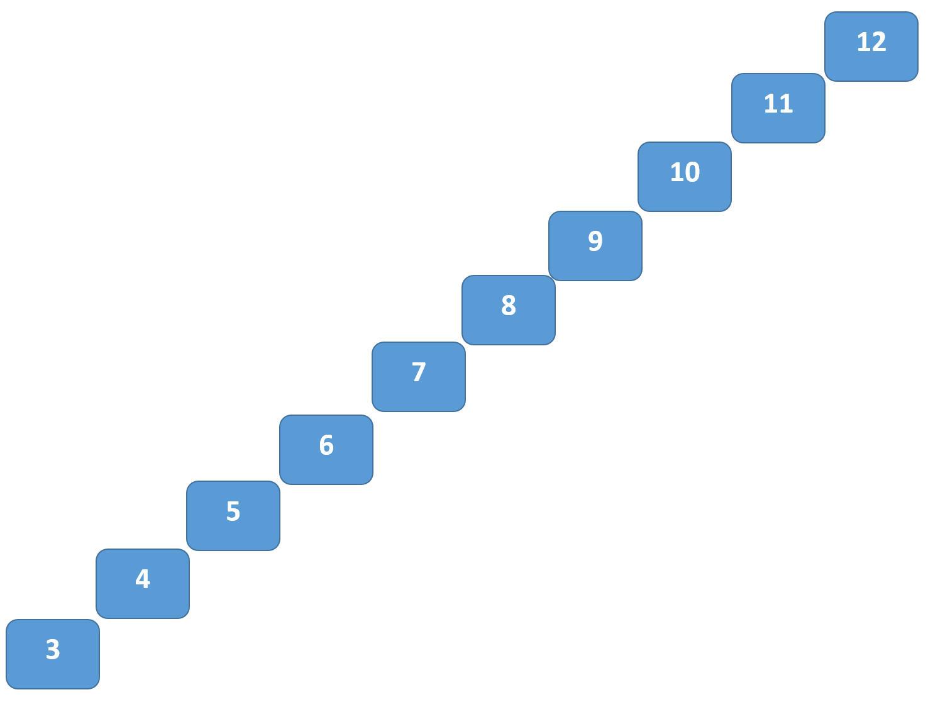
HOW we do what we do
School is Easy – Academic Foundation
Notes:
Purpose – Begin to dig into and learn all components of the consultation. Start will HOW, the SIE process & Tutoring commitments
Educate parents that even though child may be working hard at school, this frustration and lack of confidence could have been manifesting for a while – so you may think he/she isn’t “trying” but could it be they have simply given up? Wouldn’t you?
This also helps speak to the greater need here – not just help to pass one exam. For a child to be truly engaged and confident, there may be many concepts which still have to be learned and mastered before he/she begins to truly be successful.
A one time ”fix” is not fix at all!

Slide 12
HOW we do what we do
School is Easy – Recommendation Guide

Slide 13
HOW we do what we do
School is Easy – Success Pricing and Strategy

Slide 14
HOW we do what we do
School is Easy – Tutor Matching

Slide 15
Next Steps
Learn and Practice How we do what we do.
SIE & Tutoring Process
SIE Homework App
Assessments: Learning Style, Learning Loss and Academic Foundation
Learn, Understand and Apply, How we do what we do
Recommendation Guide
Success Packages and Pricing
Tutor Match
Notes:
<

