Slide 1
The School is Easy HOMEWORK APP.
February 2022_v1.6

Slide 3
School is Easy App
An on-demand tutoring app - get help anytime, anywhere.
Our Homework App is ideal for help with homework, test preparation, last minute questions and to supplement the sessions with your regular tutor.
It is very easy to use. Just request a tutor for the subject you need with a quick tap and get connected in less than 60 seconds.
It is very affordable. Just Pay by the minute* and you use only as much time as you need!

Slide 4
Features
The state of the art App is intuitive and easy to use and comes with all the features you need:
Photo/homework upload
Chat box, audio and whiteboard
Session storage
Available in smartphone and tablet

Slide 5
How it works
Interaction between OPUS and the App
When a user signs onto the App for the first time, the app will retrieve the users information from OPUS to create a profile for the App.
Franchisees and tutors are paid through Stripe
After a session, the App will calculate and transfer the amount owed to the franchisees Stripe. Franchisee balance is scheduled daily.

Slide 6
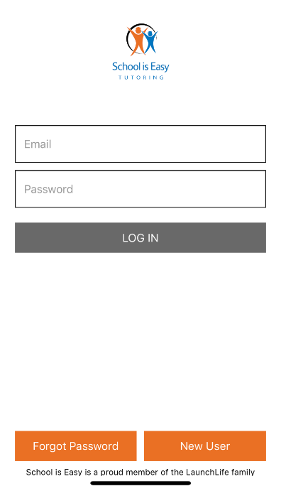
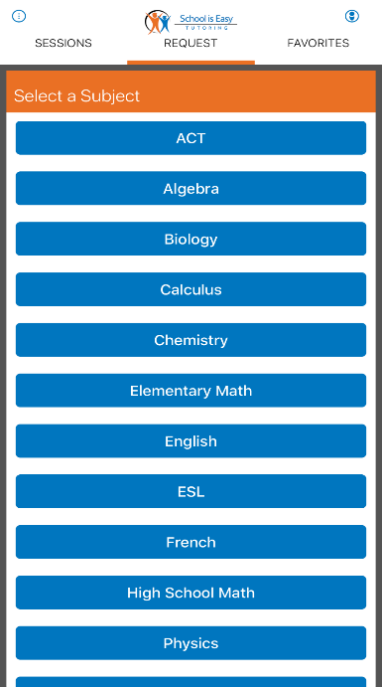
Functionality
Student login
Login Screen Select a Subject Find a tutor and request a session Chat with your tutor using text or the built in mic.

Slide 7
Functionality
Student login
Whiteboard Add the tutor to your favorites
so you can request them directly

Slide 8
Functionality
Tutor login
You will receive direct Chat with students Change your availability
requests or a first available request

Slide 9
Demonstration
Click here to watch the demo

Slide 10
Instructions for Students
Enrollment process for students who only want the app component.
They need first to be enrolled in School is Easy

Slide 11
Instructions for Tutors
On-boarding process for tutors using app
Tutors need to first enrol into a Stripe account for their country or residency

Slide 12
Business Model
Split for SIE APP revenue is:
Tutor 40%
SIE Franchisee 35%
Tutit: 15%
LLI (8% Royalty 2% Marketing) 10%

Slide 13
Business Model
SIE APP US Pricing:
Fee for students/family 75 cents per minute.
10 minutes minimum. 45/hour
Tutor pay scale: 18$/hour.

Slide 14
Easy!

