Slide 1
Notes:
First goal of the consult? - RELATE. Take the time to connect with them and show warmth and care. Joke, chat, introduce each other.
CREATE RAPPORT:
Thank you so much for meeting with me today <name>. I know when you called earlier you were talking about <child’s name(s)> and that he's <really struggling in math>. I want to let you know, you have come to the right place.
SET THE AGENDA:
So during our time together, I will be asking you some questions to get a better understanding of < child’s name> needs and if possible, I’d also like to do a little work with <child name> or you, so I can assess where he/she is at now. We’ll also talk a little bit about why <child> may find himself in the position he is today.
Then at the end I will make some recommendations and you can decide what you want to do from there.
How does that sound?
<Segway to next slide>
So let me first just introduce to you a little bit about School is Easy, and how we do what we do.
<Ask> Do how we work? ……………. great.

Slide 2
The School Is Easy Process: - The 5M’s
How we do what we do
Meet: consultation and student assessment
Make a plan: We evaluate your student’s needs and goals. Then we make a plan to help your student reach those goals.
Match: We match your student with a tutor that is the best suited for his/her academic needs, personality and learning style.
Monitor: Session Logs are emailed to you after every session. Session Logs allow your School is Easy Director to monitor your students progress at every stage.
Modify: As we get to know your student, or as things change, we will suggest modifications to the plan to better address your student’s needs and goals.
Notes:
Purpose of this slide: Set’s the agenda of the meeting so parent knows what you will be covering AND keeps CONTROL of the meeting so it stays focused.
<say>
So <parent name>, are you familiar with School is Easy and how we work? …….
Right, we send a tutor to your home for one-to-one teaching. That’s why I asked to meet with you today.
Step 1 is what we are doing right now. I’m going to be asking you some questions about <child’s name> past and current struggles with school. It’s important that I understand not just his/her academic requirements, but also his/her personality and learning style and you’ll see why that’s important when we get to step 3.
Step 2, The goal of today is that we agree on a plan for <child’s name(s)>. So, once I understand what your expectations are and the needs of <child’s name>, I will make a recommendation that will best move him/her forward.
Step 3, So from there, I’ll consider all of the information you have given me and work to match <child name> with a tutor who is best suited to assist him. We find that students learn much better if we have a good match in place.
Step 4, After that, <parent/guardian name>, we're going to monitor his progress, and you're going to be included in that process. After each tutoring session we will send you an email which we call a session report, it's mini reports from <child’s name> tutor, it's three to four sentences long and it summarizes what happened in that particular session.
You'll get a copy of it and I will get a copy of it.
The beautiful thing about session reports is they become part of your client file for as long as you're working with us. So if we ever had to go back and reread them, if we ever had to replace a tutor or a new tutor came on the scenes, they can quickly educate themselves about what's been happening during the tutoring sessions and how <child’s name> has been progressing.
So these session reports are really important – they keep all of us in the loop.
Step 5, And then, as needs change we will make any modifications to <child’s name> tutoring plan. For example, there may be a change of subject; this semester we’re talking about math, but next semester, if he's taking physics, we might need to make an adjustment in his tutoring to accommodate that.
<Ask> How does this sound so far?...........great
<Segway> <say>
Okay, so let’s carry on. I am very excited to show you this next slide.

Slide 3
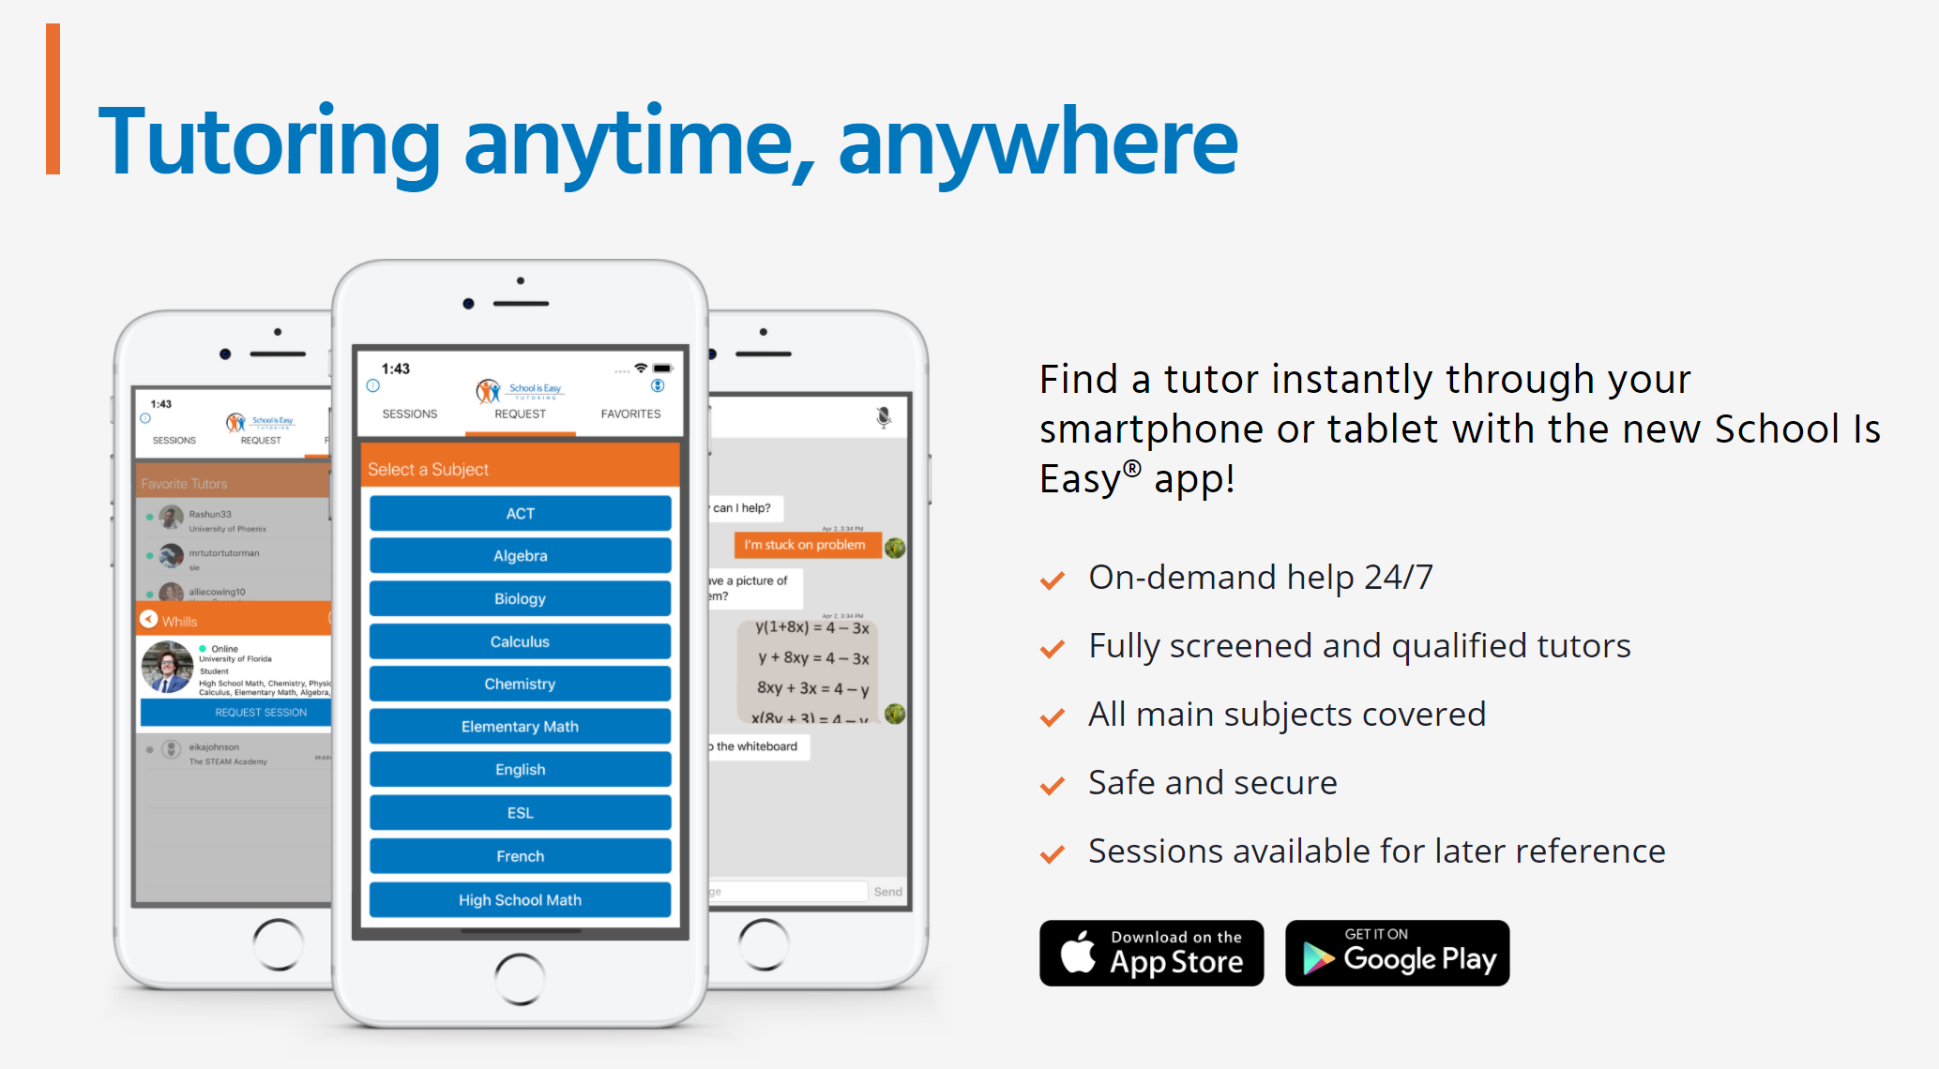
Notes:
Purpose of this slide: Introduce SIE App. Another SIE differentiator and how we are focused on the child’s success and lifting the homework burden from the parents.
<say>, Tutoring anytime, anywhere
<parent/ guardian name>, picture this, <child’s name> comes home with homework, it doesn’t matter which subject, and he/she wants some help,. “Hey, <Mom/Dad> do you remember how to do this?” And you’re thinking to yourself, OH No, I don't remember that ………..
Well, guess what? You don't have to remember that. And it's okay if you've forgotten. I've had some very funny stories from families who tried to help their children with subjects. They just don't recall.
Anyway, Your child can simply download the app. They can click into the subject they need, maybe it's French, and guess what it does, it pushes out a notification to all of our tutors who teach French - one of them is going to respond with, “ <child’s name(s)> I can help you with that homework” then tutor puts <child’s name> inside this virtual classroom.
Here, <child’s name(s)> can record that session and can favorite the tutor if they like them.
Help on demand! You don’t have to feel bad for not being able to help – instead you have peace of mind knowing <child’s name> is always getting the support he/she needs when he/she wants it.
<ask> Do you think that would be helpful to <child’s name> when he get’s stuck on a homework question? ………… Great………
<ask> How about you - Would that take some pressure off you? ……….. I thought so……
<Segway>
So that is just a quick highlight and we can talk more about the app later.
Now let’s move on.

Slide 4
Student Profilees.
Name
Grade level
Subjects currently taking and grades
Grades in same subjects last year
Areas of concern
Any assessments, report cards or teacher comments available?
Student personality
Student Interests
Notes:
Purpose of this slide: (ASSESS)Get all this info to go into opus to help with the tutor match and orient the tutor to the new student. listen to parents and let them talk about their concerns. makes notes and let them know that you are paying attention and making notes while they talk.
<Say>
Okay, so now I’m going to ask you some questions and take notes.
I’d like to have a clear picture of where <child’s name(s)> is now and where you’d like him/she to be in the future.
Notes:
Begin to ask the questions and here are some follow up questions to help gain a broader perspective:
Q 3, & 5,
<Ask> And what school is he going to?
<say>
Let's just go through the subjects that he's taking. Actually. I think you told me that this semester he's taking <English> and <math>.?
How is he/she doing with those?
What are the other subjects she/he is taking?
How is <child’s name> doing in that course? Does he enjoy the class? What does he like/dislike? What are his marks?
Q 4
<ask> For those subjects, do you recall her/his marks in the previous years?
<note, you will want to refer back to these marks when you discuss slide: Academic Foundation>
Q 6
<ask>
Why tutoring and why now?
What feedback have you been given about <child name> progress? What are the concerns?
Are these the same concerns you have? What are your concerns?
What do you envision for <child name>? What are your hopes for <child name>?
What are your expectations?
At the completion of <child’s name> tutoring journey, what would success look like to you OR how would you know the journey has been successful OR how would you talk about School is Easy to your friends?
Q 7 & 8
<Ask>
How would you describe <child name>? What’s he/she like? What motivates him/her?
Does<child name> have any special interests? example: reading, friends, sports, hobbies, cars, fashion etc. etc.
<ask follow up questions such as>
What is it he/she enjoys about that? Is he/she good at it?
What types of books does she/he enjoy? Any favorites?
Why?
Tell me more about that.
<ask this last question before moving on>
Is there anything else you would like me to know about <child name> that we haven’t already touched upon?
<Segway>
<say>
Okay, this gives me a good picture of <child name>, where he may be struggling and where you would like him/her to be going forward.
Now I’d like to find out about her/his learning style.
<next Slide>

Slide 5
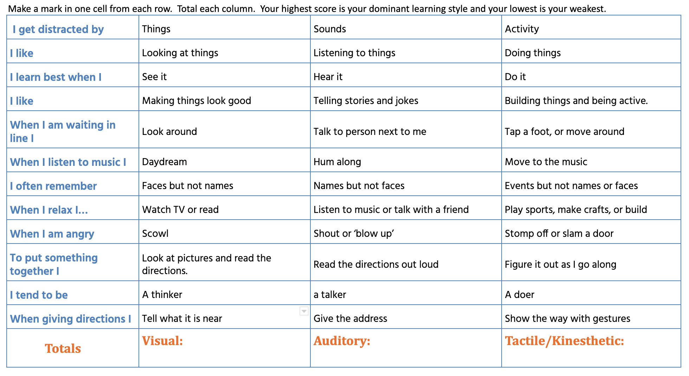
Find your Learning Style
Notes:
Purpose of this slide: (ASSESS) Work through this with the parents/ student. put the results in the student profile. At this time, do any other assessments that you need to for this student. spelling test, reading test, etc.
<say>
Okay, I'm going to ask you some questions about <child’s name(s)>, you tell me what it is, just the first thing comes to your mind, or your best guess. I’ll keep track of your answers and we’ll discuss it at the end.
<ask>
Sound good? …………. okay, here we go
<begin at the top and read aloud as outlined below & track parent’s answers>
<say>
So does <child’s name(s)> get distracted by things? Sounds or activities? activities?
And does he/she like to look at things, to listen to things, or do things?
Does he learn best when he sees something, hear something or does something? Okay.
Does he like to make things look good? Does he like to tell stories and jokes or build things and be active?
<etc etc to end of list>
<Note: at end of list, count up number of response for each: Visual, Auditory, Tactile/Kinesthetic. Highest number represents child’s learning style>
<say>
This assessment just gives us an of idea of what his learning style is. We have three primary learning styles here a visual learner, an auditory learner, and the tactile or kinesthetic learner.
So <child’s name(s)> came out with <X points in the tactile kinesthetic learner, X points in the visual and X pts for auditory>.
<say>
So what does that mean? And why does it matter?
It matters that we know this because it affects the way that the tutor will teach him/her.
So somebody who is a tactile / kinesthetic learner learns best by doing.
the tutor is not only going to have to demonstrate how to solve something, but the mastery will come for <child’s name(s)> in doing it in the practice. So practice by doing is going to be important.
A high score in auditory, on the other hand would have the tutor giving <child name> different explanations, and talking about it.
- Speaking and explaining would be helpful to his/her learning.
With a Visual students may be motivated by puzzles, writing, crafts and movement. We may want to integrate such things as , videos, flashcards, post it notes, graphs and using visual cues from real life situations (maps, photos, menus etc ) to assist with their learning.
But in <child’s name(s)>'s case, He/she has a high score in the <type> learning style category and I will communicate this to he/her tutor so they can work with <child name> in a way that is best suited to him and that he will enjoy.
So very simple, knowing the learning style gives us more insight into <child’s name(s)> and how we can help.
So thanks. Thank you for working through that with me.
NOTES:
from here and depending on the challenges of the child, you may ask the child to be present so you can assess their current reading or spelling level.
When conducting these two assessments always start at a higher grade level and work to lower levels moving from on to the other seamlessly, without indication that you are moving from one grade level to another. When child can provide more than 10 correct answers at level, we consider that is their current level.
Assessment Tools:
Spelling
Reading
Sharing Results:
Use wisdom in when and how to share results. Do not reveal the current level to the child - we do not want them feeling badly about themselves. If a student is significantly behind and insecure you may want to say:
“Great! Thank you so much for working with me, here is a orange, SIE pencil you can have for doing such a good job. You are all done, so you can go and play now. You were awesome!”
OR
You can also write the grade level of the test and results on the papers that the student wrote on, and then pass them to the parents quietly.
Sometimes you can speak to the child candidly with sensitivity:
For example: “You got 9 out of 10 on reading comprehension. Good for you! That means that even though the actual reading is a bit tough for you, you remember and understand what you read. Your tutor can help make the reading part easier.”

Slide 6
The 4 C’s of tutoring
Commitment
Collaboration
Communication
Consistency
Notes:
<Segway>
<Say>
So you've given me some information about <child’s name(s)>, now, let me tell you a little bit about School is Easy tutoring and how we help struggling students succeed at school/
<Say>
First, tutoring works when there is a commitment to the tutoring journey.
What I mean by that is; Tutoring is not a quick fix. It's not something that one session will solve. For example, if you came to me and asked me to tell you why two plus two equals four, we could probably do that in one session, as long as that was the goal of the tutoring plan.
But where we have a situation where <child’s name(s)> is struggling, and you're looking for him to master these concepts to a more comfortable level, that's going to take time.
That’s going to take commitment to the process. So he/she is going to have to show up regularly, meet with his/her tutor, and be engaged in the learning.
At the same time, that commitment comes from you as the parents. Commitment to the plan we agree upon. Supporting the schedule, not canceling sessions because your child is “double booked”, helping him/her be prepared for each session and also being engage in the process.
Secondly, collaboration. School is Easy is not the sole solution to the problem.
What I mean by that is, it doesn't matter if we think your child is doing fantastic. Let’s say we give him the proverbial “gold star”, and then he/she goes to school and fails the next exam. My gold star and praise is now meaningless to him.
It's in school where it matters – that’s where he/she gets the marks that affect his/her self esteem. And so being able to collaborate with his/her teacher will make a big difference. Also, continued collaboration with you, <parent/guardian name>, is important - nobody's going to know your child better than you.
The next key point is communication.
It’s important that <child’s name(s)> loves his tutor. The reason we go through this whole process and learning as much as we can about your child is so that we can select the right tutor. Do we always get it right? Yeah, we usually do. But if we didn't, I want to know about it, I want to know that you didn't feel that the tutor match was good, because that tutor match, and that connection between <child’s name(s)> and the tutor is a huge piece of him enjoying and committing to the process.
The last thing, like anything in life consistency.
The more consistently <child’s name> is engaged in the learning process, the more consistently he is with meeting with his tutor, the more his/her skills will build.
Example: Let’s use sports as an example: So let’s say <child’s name(s)> loves soccer. When he/she is five years old, they go to practice every week, and as they get better, the more practice they do. And , when you look at somebody who becomes a professional soccer player, what do they do at that point, , they continue to practice, always, they never stop practicing, because it is that practice that keeps them at the top of their game.
And, so tutoring is the same thing. Consistency matters. Tutoring is about practice every week over a period of time and School is Easy, we are going to there, helping him/her practice every step of the way - that's how children and adults for that matter, start to achieve impressive results.
<Ask>
Do these points make sense to you. Is there anything here that you’d like clarification about?
Okay, great.
<Segway>
Now, I would like to discuss a tutoring plan for <child’s name> but before I do that, have you ever heard the phrase Learning Loss?
<if No is the answer, say> Okay, well I’d like to take a minute and walk you through it now – it really helps explain some of the learning challenges students face.
<if Yes is the answer, say> Great, if you don’t mind, I’d like for us to walk through it together as a reminder of one of the learning challenges students face over the holidays or a break.
<move to next slide>

Slide 7
Long Breaks Cause Learning Loss
Stop the Regression and make a jump start!
Notes:
Purpose of this slide: if student is struggling with Math or Reading this slide provides context of what happens to their learning during long breaks away from the leaning environment - it’s important to cover this before making any recommendations.
<say>
These three dots represent the levels of learning a student can move between dependant upon if they have tutoring over a break or not.
So let’s use <child’s name> as an example –
<place your cursor/pen on the middle dot & say>
The middle dot represents where <child’s name> is now.
If he/she does not work with math or reading for a period of time he/she will regress in their learning.
<move your cursor/pen back and along the line to rest on the first dot, dot to the left>
<say> That will put them here.
<place your cursor back on the middle dot> <say>
Now if your child continues with a tutor over the break, he will continue to learn and move forward to here. <move your cursor/pen forward from the middle dot and along the line to rest on the dot to the left>
Now, without the continued tutoring as we already demonstrated, the student will regress in their learning to here <dot to the left of centre>. Now look at the review and catch up he or she will have to go through just to get up to speed once they return from break,<move your cursor/pen from the left dot, following the bottom line all the way to the dot right of centre.>
<say>
That’s a lot of catch up!
<say>
So what this means is, if a student continues to work with a tutor, the difference where they can be at in September is significant and means the student can jump ahead as compared to the rest of the class.
<ask>
Make sense? Does this surprise you?
<Segway>
<say>
Okay, There is one more thing I would like to show you to help explain what may be causing <child’s name> to struggle.
<next slide>
<Notes:
Students typically lose 2.5 months of learning over the summer (North American school year & break)
The centre circle represents where a student is at in June.
The circle on the left represents where the student will be at in September if s/he does no study.
The circle on the right represents where the student will be at in September if the student studies over the summer and makes progress.

Slide 8
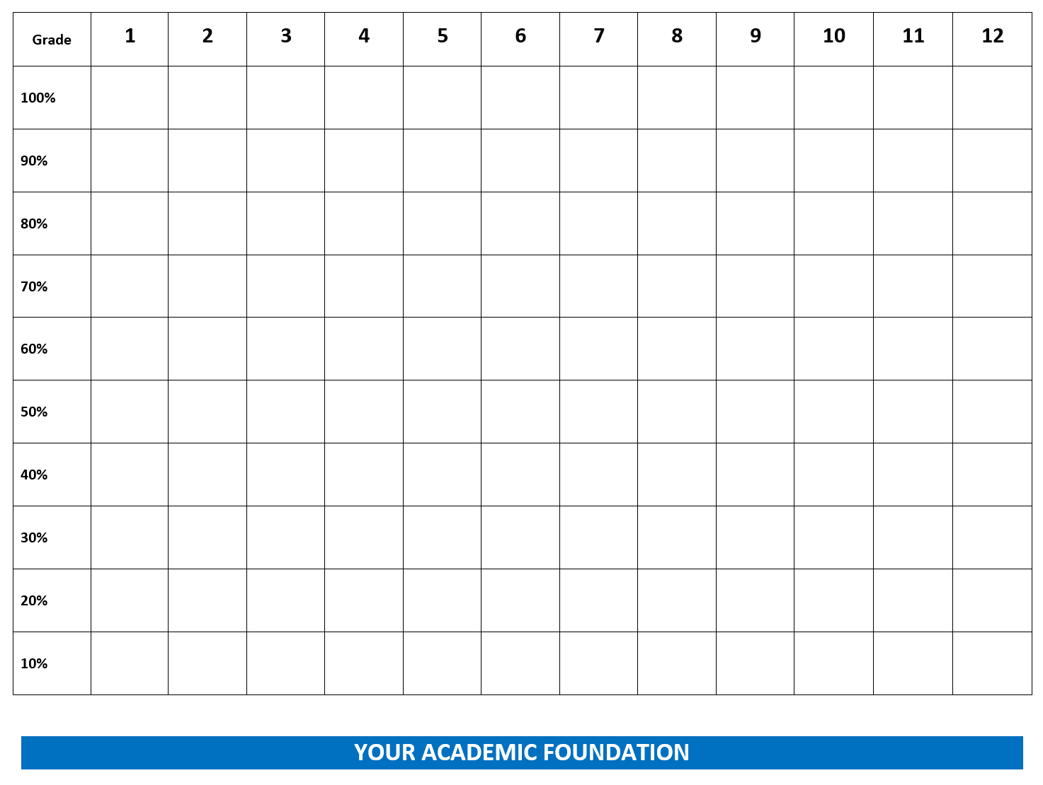
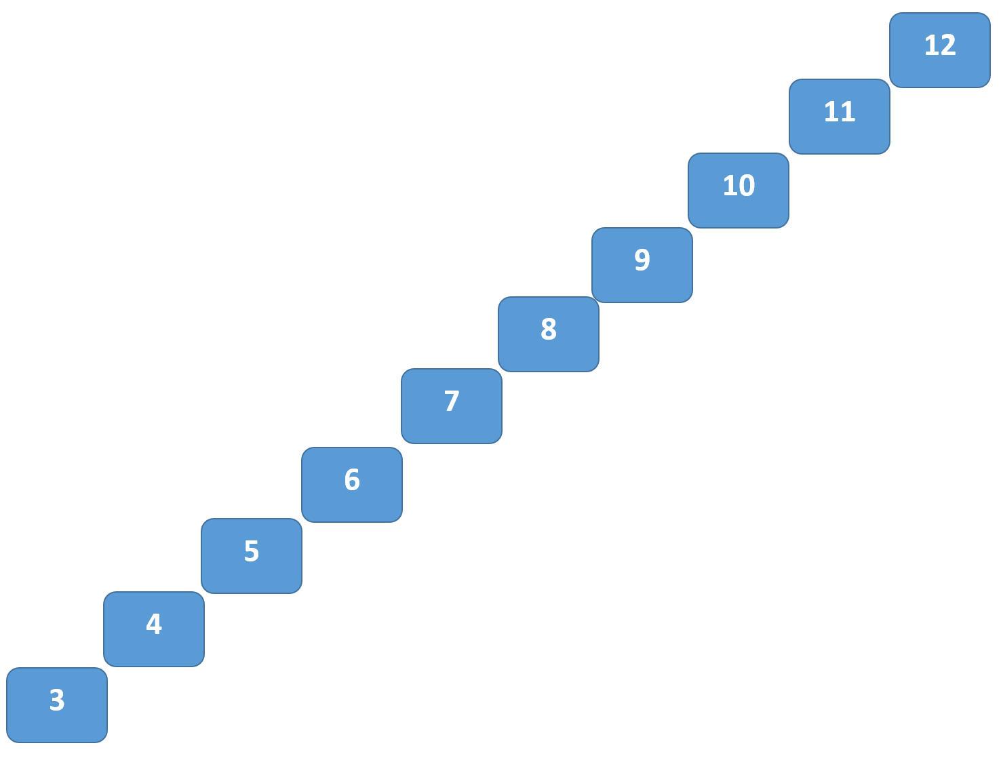
Academic Foundation
Notes:
Purpose of this slide:
to identify any possible downward pattern in the subject(s) child is struggling with.
To exemplify the importance of first learning & mastering foundational principles in order to progress successfully through the higher grades.
Prepare ahead of time for this slide by
hyperlinking the “Academic Foundation” slide title ink to the Consultation Tool: Academic Foundation (Word doc)
know how to use the Shapes tool to insert and draw a line on the Word doc.
<Notes: Refer back to your Student Profile Q4 notes and for the subject child is most struggling with (usually math or English/reading) walk the parent through the following exercise>
<Say>
So let me talk to you about your child’s the academic foundation. I'm just going to pull up another document here.
We’re going to review his/her current year and past years marks in <subject of concern> to see if there might be a trend or pattern and if there is I’ll propose a reason for that trend.
Let’s get started.
So you told me that <child’s name(s)> is in about the X% mark in X subject.
What was <child’s name(s)>’s mark last year in that subject? Do you recall?
Okay.
Do you recall where he might have been the year before that?
Okay, grade X?
<go as far back as the parent can remember – each time typing in an “X” to placemark the %mark at each grade level – you will probably find there is a downward trend; higher grades in the earlier grades and progressively lower marks as child moves up through subsequent grades>
<Say>
Okay, so let's take a look here. And I want to point out that this is for illustrative purposes only.
<looking from earlier grades to higher grades, generally marks will be higher in earlier grades and lower in the higher grades>
<draw an arrow line to highlight the downward trend of marks through the higher grades>
<say>
Look at how his/her marks have been going since grade X - we could go back to earlier grades but we seem to have a pattern already emerging. It’s showing that X subject has been progressively getting harder for <child’s name(s)>.
<say>
So why does this happen? Well, if we look back at the lower grade X, we can see here that that <child’s name(s)> was in about the <70> percent range. And that tells me that he mastered <70>% of the concepts and that was great, the Problem is, particularly with a subject like <math> <30>% of the grade <6> learning concepts, he didn't master. And those are likely to be the harder concepts.
So he didn't master his <30>% of the material. And guess what, he goes into grade <7> and that <30>% because they're the harder concepts, are likely very critical to success in grade <7>, but he didn't master them in grade <6>.
So if you take something you didn’t master and you pull it forward into the next grade, and then add one more layer of complication, that lack of foundation affects what happens in the next year. And as his/her mark slipped a little bit to <60>%, now <40>% of the grade <7> material, he didn't master.
So what happens in grade eight, when that <40>% of the concepts are critical to <child’s name(s)>'s getting the best possible mark? Well, guess what, it gets harder again. And we can see that with his mark in grade 9.
And we could carry on this illustration, endlessly.
But the whole point is to say, it's not always just <child’s name(s)>'s effort that makes a difference. Sometimes when a child has missed concepts and never really mastered them. It's very difficult to then to do the next level of work, because he/she just didn’t have the basic information they needed in the first place.
So let’s look at the grades another way <scroll down to next pg of same doc>
Let’s image the grades as a ladder of steps.
So in grade <6,7,& 8> <child’s name> did not master key foundational concepts. Now he/she is in grade <9> and he/she is struggling. Make sense?
As hard as he/she may try, they just don’t get it and may give up, get frustrated, angry etc. Sound familiar?
So, Until the child can essentially “catch up”, this pattern and cycle will most likely continue. And that’s where School is Easy can help.
we want <child’s name(s)> to feel confident in taking those steps. At School is Easy, we go back, we revisit, we retrain, unitl he/she masters those concepts and begin to move forward.
And, <Parent’s Name> that's why commitment, collaboration, communication and consistency is so important – it’s what drives our tutoring process.
How does that sound? Any questions before we outline a plan of action?
<Segway>
<Say>
Okay, so let’s review your concerns and expectations and agree on a plan forward.
<move to next slide>

Slide 9
Agreed Tutoring Goals & Plan
1.
2.
3.
Notes:
(Summarize points and gain agreement) Recap challenges, objectives / goals of tutoring sessions and agree on 2 or 3 goals for tutoring. examples: pass a test, learn how to become organized, gain confidence, etc.
<Segway>
<say>
So in order to get <child name> there, this is what I am recommending
<next slide>

Slide 10
Recommended Schedule
& Plan
Notes:
Notes: RECOMMENDATION should be stated as: 1. Frequency of sessions (number of times per week) 2. Time: length of each session 3. Duration: over what period of time (eg. 36 wks)
Also consider support materials you want them to order through amazon.
<say>
“I recommend… ___ times a week for _____ mins/hours, for a period of ______ number of weeks. (optional: We will need the ______ workbook. I will send you the link to order from amazon).
SAMPLE DIALOGUE! – “The rule of thumb is: 1x a week we can stabilize a student. 2x a week we can make progress. 3x a week we can make significant progress. Since you are wanting to have a fast impact, I recommend 3x a week.”
Note:
Before talking about price, Handle any objections about recommended schedule and gain agreement to the recommendation; the number of sessions per week, length of sessions and duration. Whether or not the parent’s first purchase is what you are recommending is not the purpose here. The purpose is to have the parent agree that commitment and consistency of tutoring and what you have recommended is the ideal and commitment and consistency is what provides the best results.
Just like everything in life, you get out of something what you put into it.

Slide 11
Price & Packages
Notes:
Review the packages with parent.
Handle objections
Agree on next steps (what is being purchased)
<Segway>
<say>
Okay, now what we’ll do is complete your enrolment form, I’ll review our Terms and Procedures with you and have you sign off. After that, we’ll square way payment details and then

Slide 12
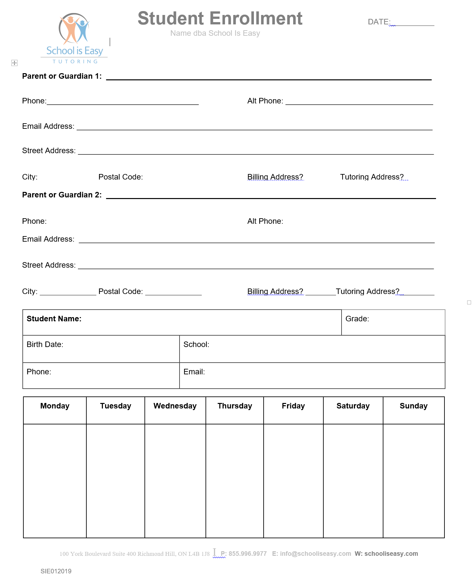
Enrolment
Form
Notes:
(ENROL) put in your enrollment form and begin to fill in with them in the meeting. “Perfect. I think that is all the info I need. Do you want to do pay as you go or pre-purchase a block of hours?” “OK great. I will email you the docusign while we are in the meeting and then I can get going getting your tutor match in place.” email it to them and work on terms and procedures while you wait for it to go through and get signed.

Slide 13
A turn-Terms and Procedures 1
SESSION LOG: The instructor will complete a session log report for every tutoring session. This information will keep everyone (Director, other instructors, and parents) up to date on student progress.
TEACHER COMMUNICATION: We support school instruction and teachers. Tutors can take teacher direction.
RESOURCES: We carry a large selection of workbooks and materials to support session content. Minimal costs cover the workbook cost and shipping. Workbooks are non-refundable.
SESSION PREPARATION: Please have the following available for each session: All relevant text and note books, returned tests, homework and daily planner.
NEW SEMESTER: When you know what courses your student will be taking in a new semester, contact us so we can confirm your tutor match, update tutoring goals, provide new support materials, and coordinate scheduling. Please contact us two weeks or more before your desired start date.
SESSION CANCELLATION: You must call your tutor 24 hours in advance to cancel a session, or you will be charged 1 hour at your regular tutoring rate.
Notes:
(ENROL) go through each of these points quickly. don’t read whole thing - just sum each point up.

Slide 14
A turn-Terms and Procedures 2
SCHEDULE CHANGES: Notify the office if you want to change your tutoring schedule. If your schedule changes, or if you would like to increase/decrease your tutoring hours per week, contact our office so we can reassess your student plan. You will need to maintain a consistent appointment time to retain a tutor’s services.
REMATCHES: We do not guarantee the same tutor for the duration of your enrollment. It is normal for a tutor change to occur at the beginning of a new semester or school year or if your tutor experiences a personal emergency or unexpected change of schedule. The benefit of working with SIE is that we can match a new tutor for you with minimal interruption. You may also request a rematch if you feel your tutor isn’t a good fit for your student.
MATH TUTORING: Different teachers have different methods. Even a brilliant math tutor may need to review before teaching a particular math concept. This does not mean that the tutor is unfamiliar with course content. We recommend emailing your tutor prior to the session with unit information.
PROGRESS: The keys to maximizing student progress are: clear goals, a regular schedule, student discipline, communication, and a compatible tutor match. If you notice a challenge in any of these areas, please contact us.
Notes:
(ENROL) go through each of these points quickly. don’t read whole thing - just sum each point up.
Make sure this reads / has same copy as wording of the Client Agreement Linked on agreement form

Slide 15
Next Steps
Meet: scheduled consultation
Make a plan: We evaluate your student’s needs and goals. Then we make a plan to help your student reach those goals.
Match: We match your student with a tutor that is the best suited for his/her academic needs, personality and learning style.
Monitor: Session Logs are emailed to you after every session. Session Logs allow your School is Easy Director to monitor your students progress at every stage.
Modify: As we get to know your student, or as things change, we will suggest modifications to the plan to better address your student’s needs and goals.
Notes:
(ENROL) Once you have the signed doc, get payment info and then go over next steps. After you finish the meeting, send a welcome email and include a copy of the student description, goals of tutoring, and terms and procedures. also include a link for any materials they need to order online.

Slide 16
Handling Objections
Common Objections
How do I know that I will be happy with the instructor you send? OR, What if I don’t like the tutor?
I want to approve the tutor.
I only want a certified teacher. OR What qualifications do your instructors have?
I will have to talk with my husband/wife/partner.
My son does not handle change well and needs to have the same tutor all year.
We need a female tutor (physics 11).
Notes:
Handling Objections:
Response: “I will be following up and if you are not a raving fan I will give you another tutor.” OR “Impossible! Our tutors are very experienced. I will send you the tutor’s profile for you to have a look at before they arrive. I will also be following up and if you are not a raving fan I will give you another tutor.”
Response: “Here’s what I’ll do, I‘ll send you the profile of the tutor I recommend and you can read it [or, I’ll have the tutor give you a call and introduce him/herself] Would that work for you?”
Response: “So I understand, is it that you want a certified teacher or the most qualified / best match to help <child’s name> with this subject?” OR “All of our tutors are screened and qualified………” / “We have several tutor types …………”
Response: “No problem, but I’d like to get started right away on matching you with a tutor. Are you wanting to decide between X & X package?” … if response is “Yes”, Say: “Okay, so lets start with this package and you can switch after your chat with wife/husband/partner.” OR “No problem, if we need to, we can switch plans once of you’ve spoken with them. Does that work for you?”
Response: “We can’t promise or guarantee the same tutor all year but, what we do is ask our tutors to commit until the end of the school year and I will look for someone whom I’m confident will do that for us.”
Response: Note: most science tutors will be male. If you get this request, ask more questions to better understand their need for a female science or physics tutor question. Ask, “Is this a deal breaker?”

