Slide 2
The School Is Easy Process: - The 5M’s
Meet: consultation and student assessment
Make a plan: We evaluate your student’s needs and goals. Then we make a plan to help your student reach those goals.
Match: We match your student with a tutor that is the best suited for his/her academic needs, personality and learning style.
Monitor: Session Logs are emailed to you after every session. Session Logs allow your School is Easy Director to monitor your students progress at every stage.
Modify: As we get to know your student, or as things change, we will suggest modifications to the plan to better address your student’s needs and goals.

Slide 3
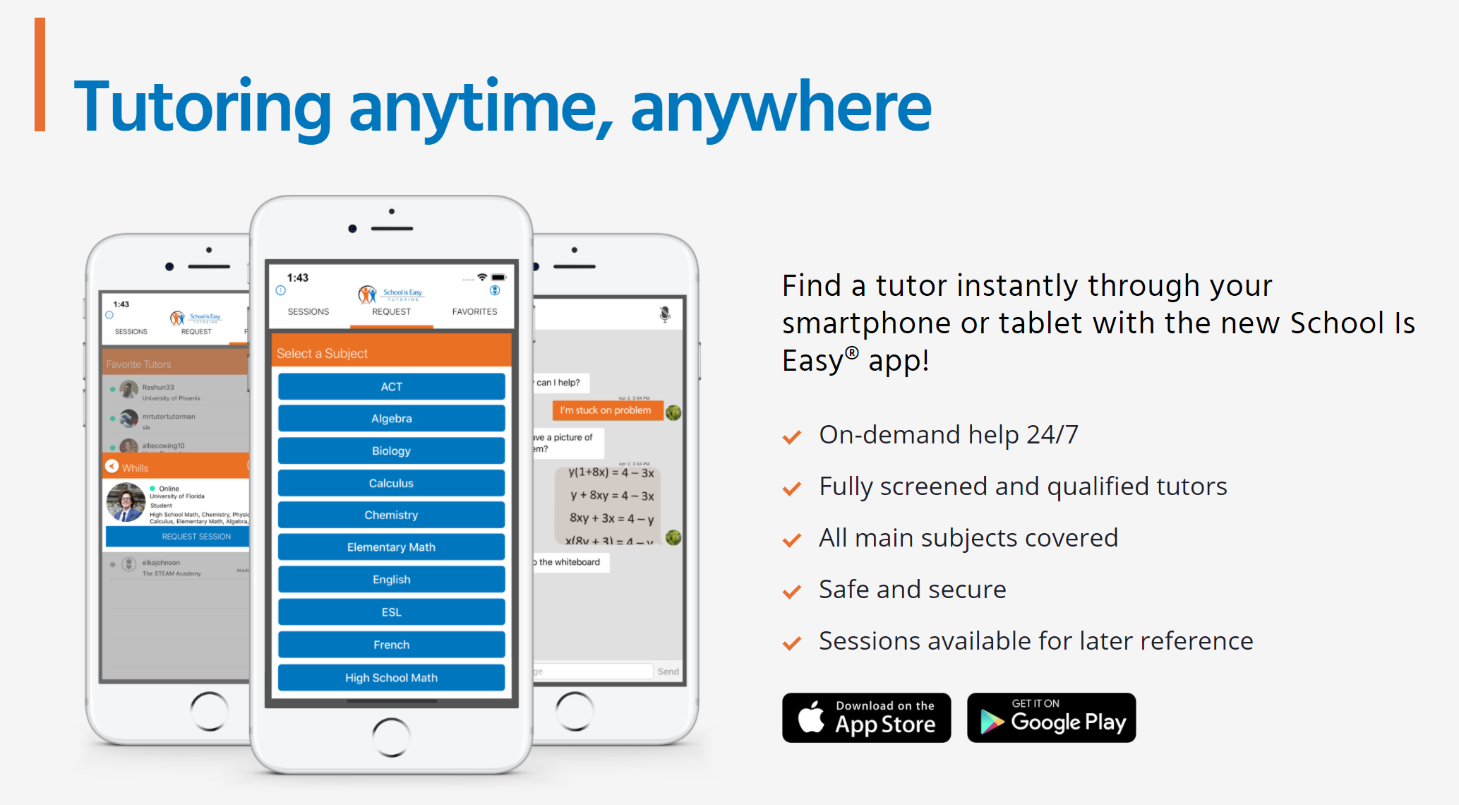

Slide 4
Student Profilees.
Name
Grade level
Subjects currently taken and grades
Grades in same subjects last year
Areas of concern
Any assessments, report cards or teacher comments available?
Student personality
Student Interests

Slide 5
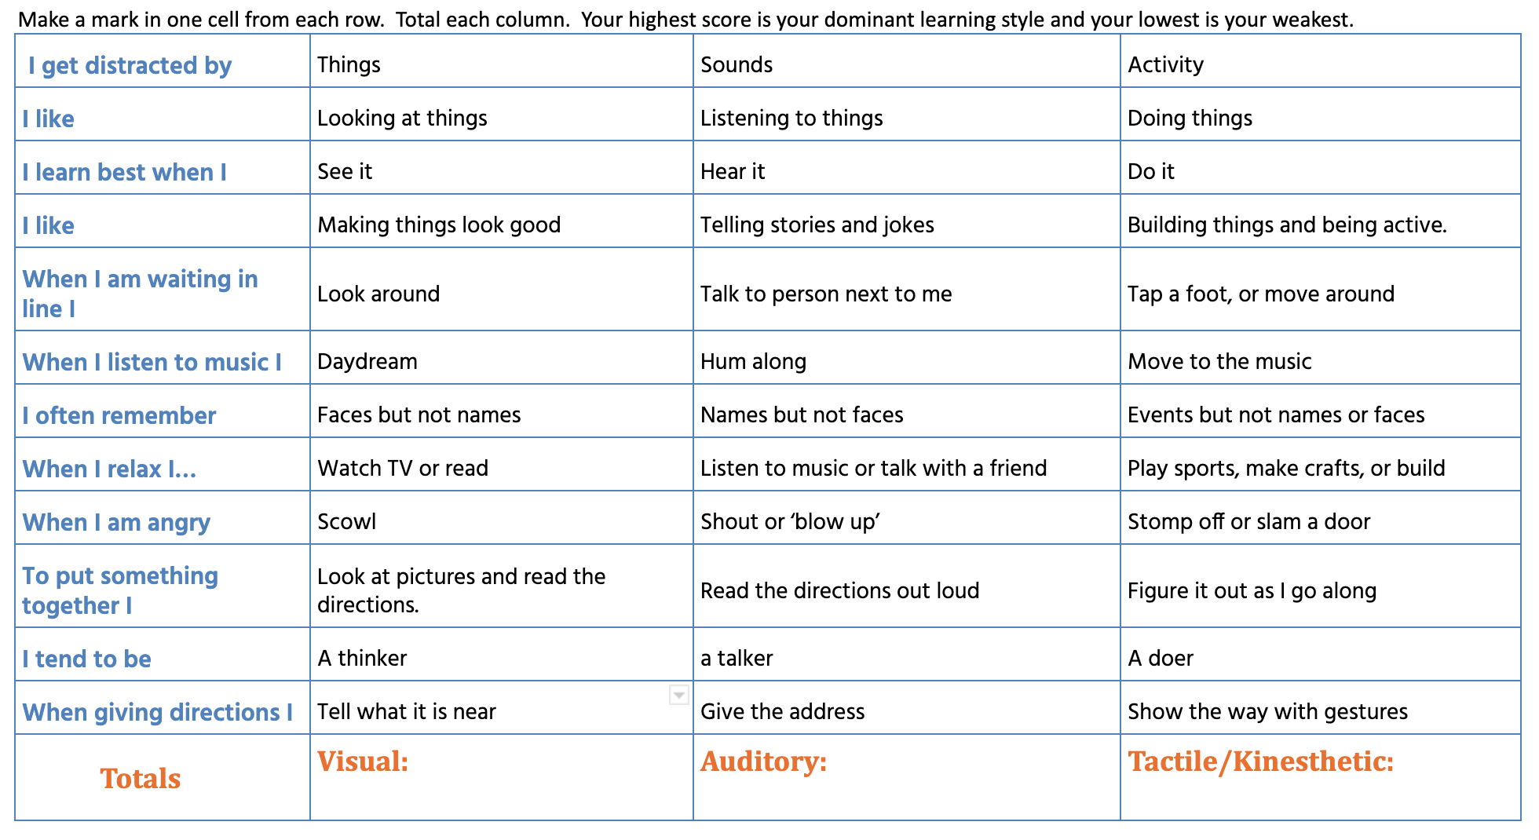
Find your Learning Style
Notes:
.

Slide 6
The 4 C’s of tutoring
Commitment
Collaboration
Communication
Consistency
Notes:
.

Slide 7
Long Breaks Cause Learning Loss
Stop the Regression and make a jump start!
Notes:
Part of (ASSESS). Giving groundwork before recommendations. / If a student does not work with math or reading for a period of time they regress in their learning. Students typically lose 2.5 months of learning over the summer. in contrast, if a student continues to work with a tutor the difference where they can be at in september is significant and means the student can jump ahead as compared to the rest of the class. The centre circle represents where a student is at in june. the circle on the left represents where the student will be at in september if s/he does no study. The circle on the right represents where the student will be at in September if the student studies over the summer and makes progress.

Slide 8
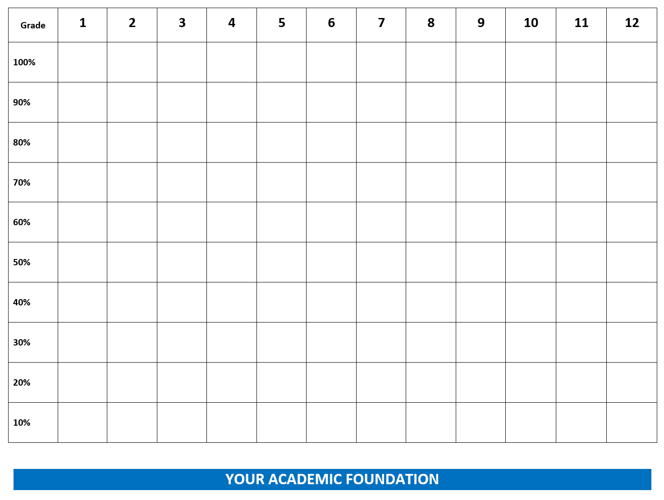
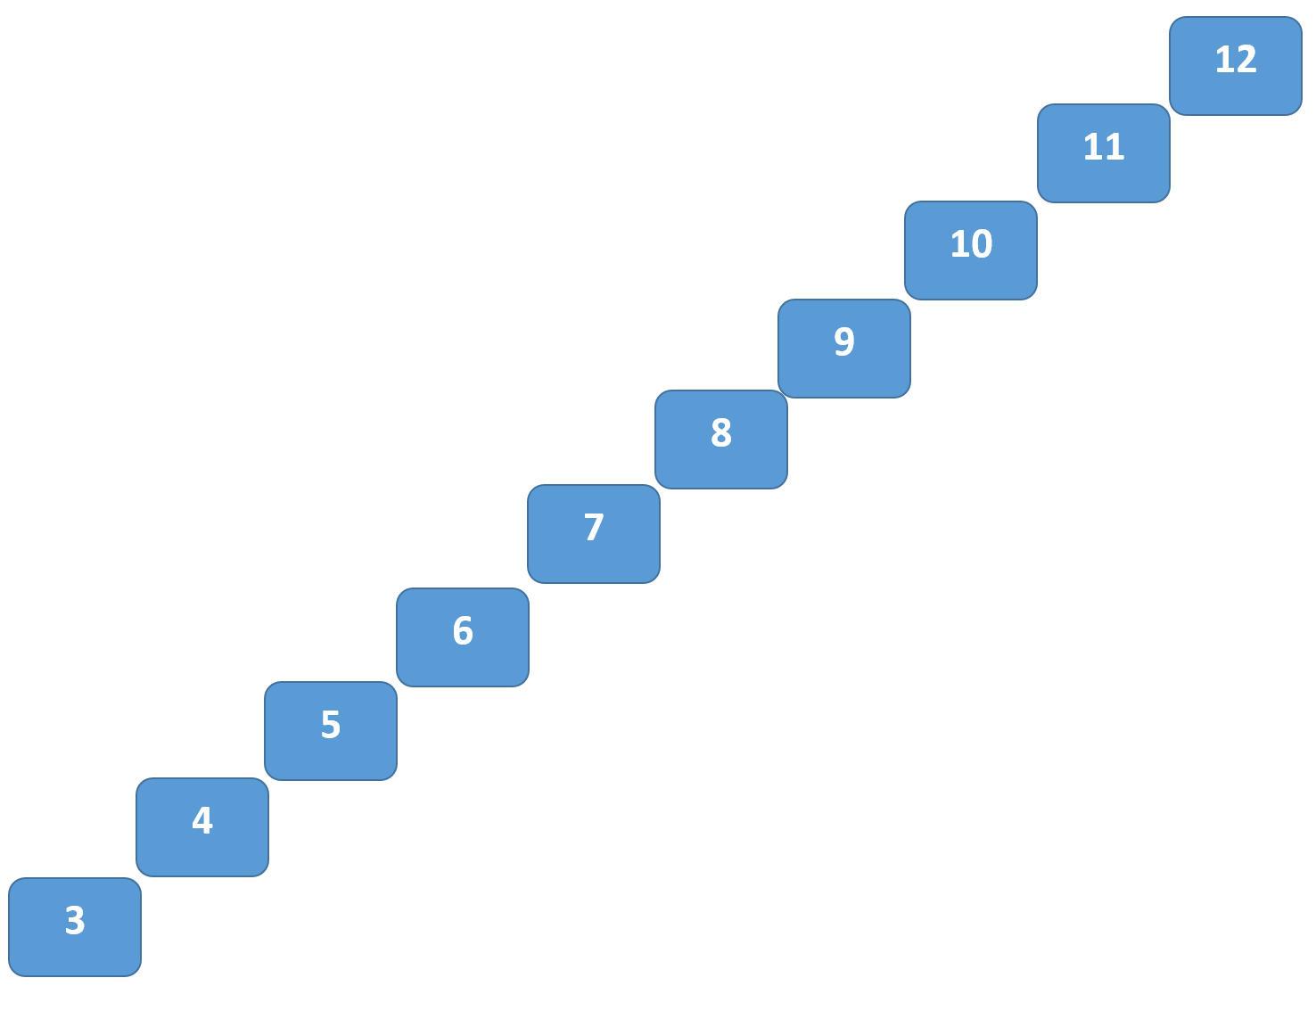
Academic Foundation
Notes:
.

Slide 9
Agreed Tutoring Goals & Plan
1.
2.
3.
4.

Slide 10
Recommended Schedule
& Plan

Slide 11
Pricing

Slide 12
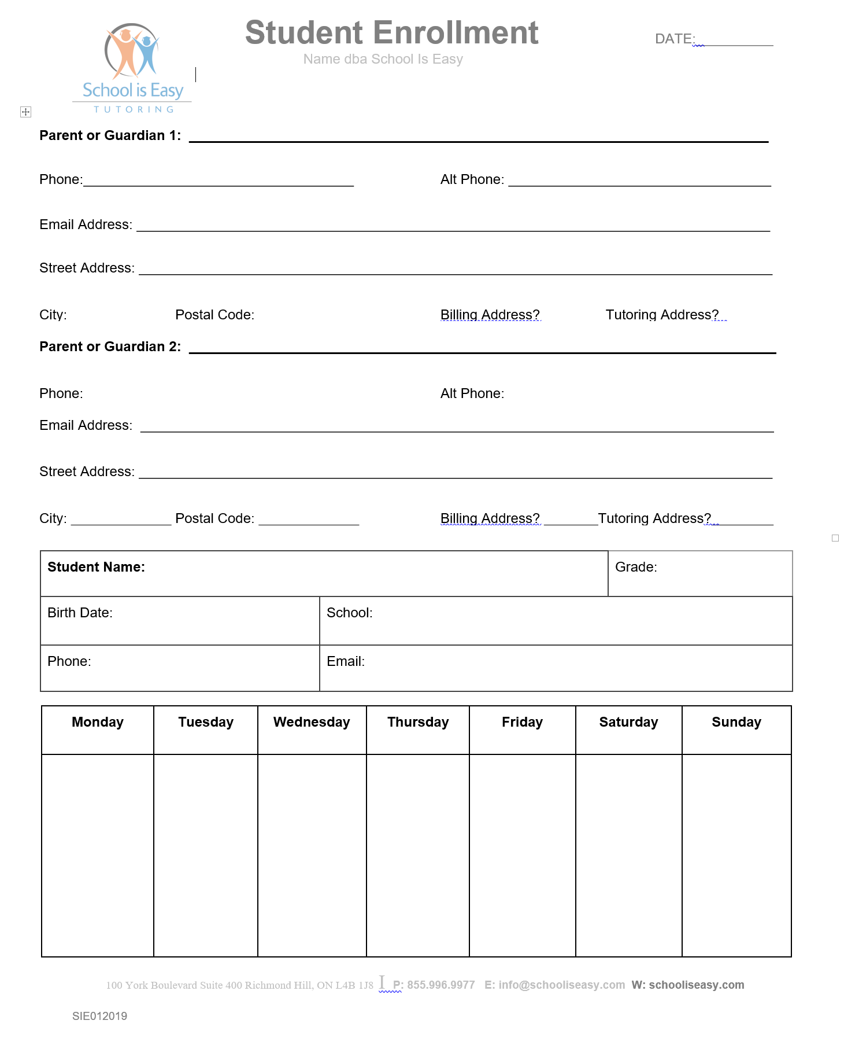
Enrolment
Form

Slide 13
A turn-Terms and Procedures 1
SESSION LOG: The instructor will complete a session log report for every tutoring session. This information will keep everyone (Director, other instructors, and parents) up to date on student progress.
TEACHER COMMUNICATION: We support school instruction and teachers. Tutors can take teacher direction.
RESOURCES: We carry a large selection of workbooks and materials to support session content. Minimal costs cover the workbook cost and shipping. Workbooks are non-refundable.
SESSION PREPARATION: Please have the following available for each session: All relevant text and note books, returned tests, homework and daily planner.
NEW SEMESTER: When you know what courses your student will be taking in a new semester, contact us so we can confirm your tutor match, update tutoring goals, provide new support materials, and coordinate scheduling. Please contact us two weeks or more before your desired start date.
SESSION CANCELLATION: You must call your tutor 24 hours in advance to cancel a session, or you will be charged 1 hour at your regular tutoring rate.
Notes:
.

Slide 14
A turn-Terms and Procedures 2
SCHEDULE CHANGES: Notify the office if you want to change your tutoring schedule. If your schedule changes, or if you would like to increase/decrease your tutoring hours per week, contact our office so we can reassess your student plan. You will need to maintain a consistent appointment time to retain a tutor’s services.
REMATCHES: We do not guarantee the same tutor for the duration of your enrollment. It is normal for a tutor change to occur at the beginning of a new semester or school year or if your tutor experiences a personal emergency or unexpected change of schedule. The benefit of working with SIE is that we can match a new tutor for you with minimal interruption. You may also request a rematch if you feel your tutor isn’t a good fit for your student.
MATH TUTORING: Different teachers have different methods. Even a brilliant math tutor may need to review before teaching a particular math concept. This does not mean that the tutor is unfamiliar with course content. We recommend emailing your tutor prior to the session with unit information.
PROGRESS: The keys to maximizing student progress are: clear goals, a regular schedule, student discipline, communication, and a compatible tutor match. If you notice a challenge in any of these areas, please contact us.

Slide 15
Next Steps
Meet: scheduled consultation
Make a plan: We evaluate your student’s needs and goals. Then we make a plan to help your student reach those goals.
Match: We match your student with a tutor that is the best suited for his/her academic needs, personality and learning style.
Monitor: Session Logs are emailed to you after every session. Session Logs allow your School is Easy Director to monitor your students progress at every stage.
Modify: As we get to know your student, or as things change, we will suggest modifications to the plan to better address your student’s needs and goals.

