Slide 1
Tutor Hiring Processes
April, 2021

Slide 2
Qualities of a Good Tutorsuccess.
Likeable
Caring
Good Communicator
Mentor

Slide 3
Recruitments.
Universities/Colleges – departments, tables, job boards, tear-aways - (hiring today! - sandwich board)
Coffee Shops
Online Job postings
Events
Referrals - referral bonus

Slide 4
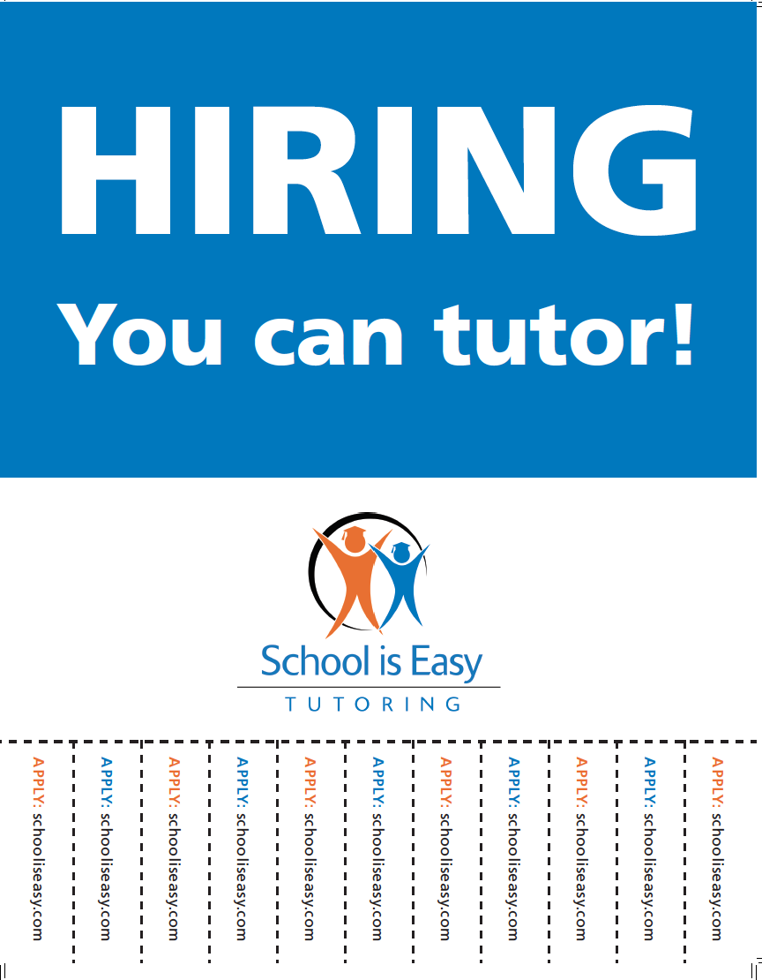
Tutor Recruitment Poster

Slide 5
Sample Tutor Ad

Slide 6
Contractor vs Employee

Slide 7
Interview
In person
Schedule back-to-back interviews 20-30 min apart OR conduct group interview
Have a system
All documents in SIE folder
Background Check info and directions
2 copies of contract- if contractor
Getting started Checklist
Bank info doc
Compensation grid
Application
Policies and procedures
Notes:
Go through each of these documents

Slide 8
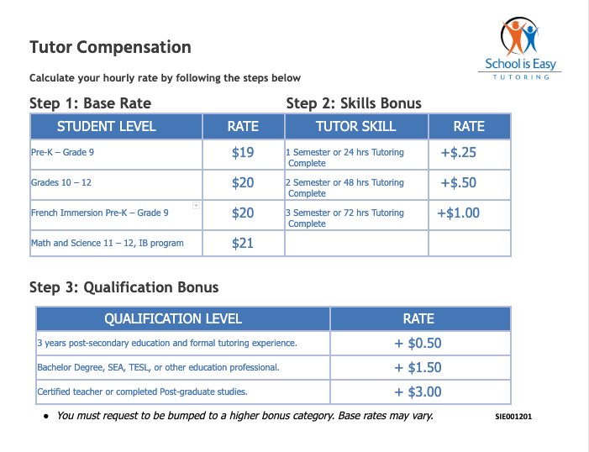
SAMPLE
Notes:
Go through each of these documents

Slide 9
Orientation
Group Online – 45 min to 1 hour

Slide 10
Retention success.
Making a difference - part of something bigger
TEAM: Great support and open communication
You (owner) handle the tough stuff
Tutor Rally / Tutor BBQ
Provide positive feedback
Prompt easy pay
Retention bonus
Referral bonus

Slide 11
Tutor Profile
Example profile:
Valerie is an inspiring and creative tutor who enjoys working with Math & Science courses. She is currently working towards her Bachelor's Degree in Chemistry & Physics, where she frequently enjoys straight A's! As a subject specialist, Valerie has honed her tutoring skills by teaching Piano, and has spent her summers as a camp counselor. She looks forward to working with you to achieve your educational goals!

