Slide 1
Google My Business Optimisation Guide 2020

Slide 2
01
What is Google My Business
02
Adding your business information
03
Managing Access & Location Groups
04
Any questions

Slide 3
What is Google My Business?
Google My Business is a free tool that lets you manage how your organisation appears on Google Search and Map results.
The basic rule of thumb, is that the more you fill in, and the more interaction users have with your listing and you with them, the better your listing performs.
Basics include adding a business name, location, opening hours, photos, monitoring and replying to customer reviews, learning where and how people are searching for you and more.
To learn how to create your Google My Business account, verify your business locations, service areas and optimise the listings for maximum performance, MediaCom have put together this easy to follow guide.

Slide 4
What does GMB Do?
We have used a Jewellers based in London as an example of a well-optimised GMB listing, which performs well for relevant search terms within the search and map results.
If you’ve ever searched for a business’ name, you’ll often see their “knowledge panel” appear.
This is a card containing important information customers might want to know about local businesses.
If you’re on mobile, it will often be the top result, below the paid ads but above the traditional organic results.
If you’re on a desktop, it will be displayed just to the right of the organic and paid search results.

Slide 5
Adding your information

Slide 6
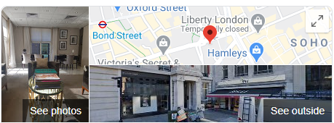
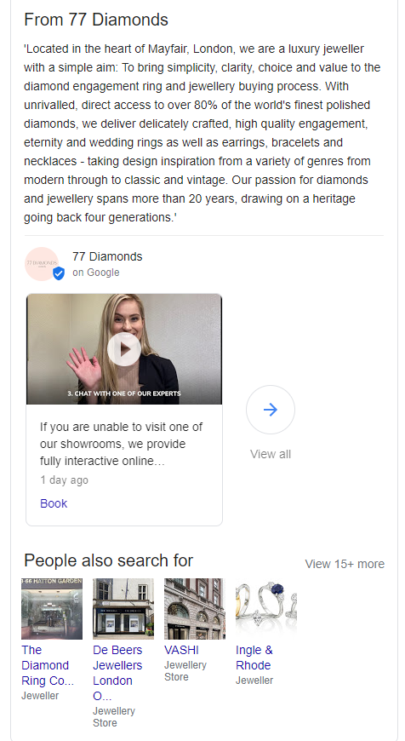
What can you add to GMB?
As you can see, the knowledge card displays a lot of valuable information customers would want to know:
At a quick glance, you can learn a lot about a business and whether or not you want to visit or call.
That is exactly the point of the tool: to give customers enough data about a business to help them determine if they want to engage with that business.
Business name | Business Type (Category)
Address | Hours of operation
Phone number | Link to website
Images | Link to Google Maps
Reviews | Overall Star Rating
Popular times to visit | Related Searches & More

Slide 7
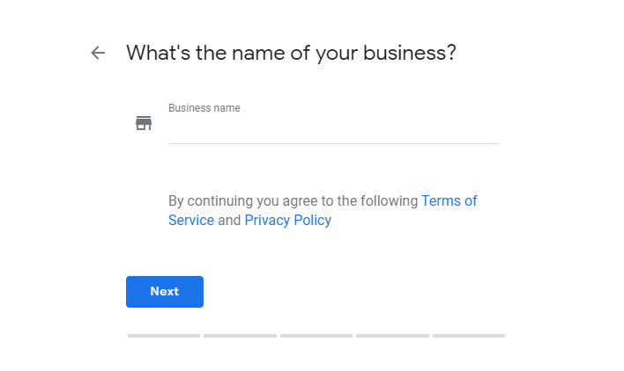
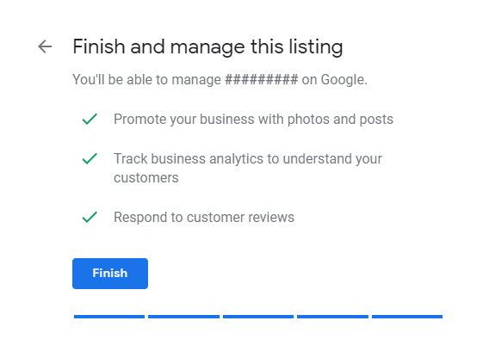
Complete your business information
The 5 first steps and all you need to get started on GMB are:
Business name
Business category
Location
Phone number
Website URL
Follow these initial steps to create a business listing and then choose a way to verify and confirm. This can be done one of 3 ways, via email, phone or postcard. For more information on how to verify a listing click here.

Slide 8
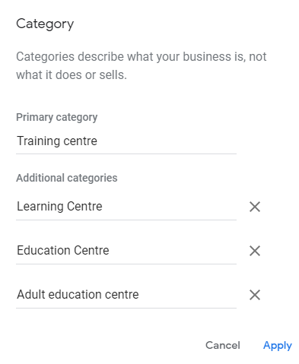
Choose your categories
You can choose up to 10 categories for each listing.
However, you can only choose one primary category, which Google gives the most weight to. So choose your primary and secondary categories wisely.
Don’t choose more than necessary as this could dilute the focus from the primary category. We would advise 2 to 3 is optimal.
You can’t create your own category. If the category you had in mind isn’t available, choose a more general category that still accurately describes your business.
If you add or edit one of your existing categories, you may be asked to verify your business again. This helps Google confirm that your business information is accurate.
More information on business categories here.

Slide 9
Add a business description
Google now gives you 750 characters (~250 characters before the “Read More” separator) to describe your company, building, product or service - or other important information you want to communicate to your audience.
We highly suggest you make full use of every character, with a business description between 730-750 characters.
Every sentence, phrase, word, character tells the buyer more about you.
Use keywords – as descriptions also improve your search rankings in Google.
Just as you’re able to communicate who you are to customers, you’re able to tell Google the same information, and they can use this information to rank you for even more search queries.
Full business description guidelines available here.

Slide 10
Upload great images
Here’s a fun fact about images on your GMB listing straight from Google:
“Your listing is a great place to showcase the photos that capture your business. Businesses with photos receive 42% more requests for driving directions to their location from users on Google, and 35% more clicks through to their websites than businesses that don't have photos.”
Take high quality interior pics of your buildings or offices, and take exterior pics of your building so users know which building is yours.
Other people can upload images to your listing too, so you should encourage happy customers to also add photos.
*Photos should be at least 720 pixels wide by 720 pixels tall, and either a JPG or PNG.

Slide 11
Moderate user images uploaded
If you do have users sharing photos, don’t forget to moderate them. To do this, select ‘By customers’ in the photos section.
While you cannot delete images, you can report them for a number of reasons:
Images posted by mistake, or that have nothing to do with your business
Poor quality images you don’t want representing your business
Images that may be offensive or should remain private
Use the flag icon on the top right (when viewing an image) to submit a report. Google Support will review this and take the appropriate action where required.

Slide 12
Reviews
The reviews on your GMB page can be a big deciding factor in whether or not a user engages with your brand. Here are some statistics:
85% of consumers trust online reviews as much as personal recommendations
68% of consumers left a local business review when asked
30% of consumers say they’ve judged a business based on its responses to reviews
Positive reviews make 73% of consumers trust a local business more
Responding to good reviews helps
Responding to good reviews gives an even better impression of your business. They are easy to respond to, you could even just do a quick copy & paste from a bank of pre-written replies.

Slide 13
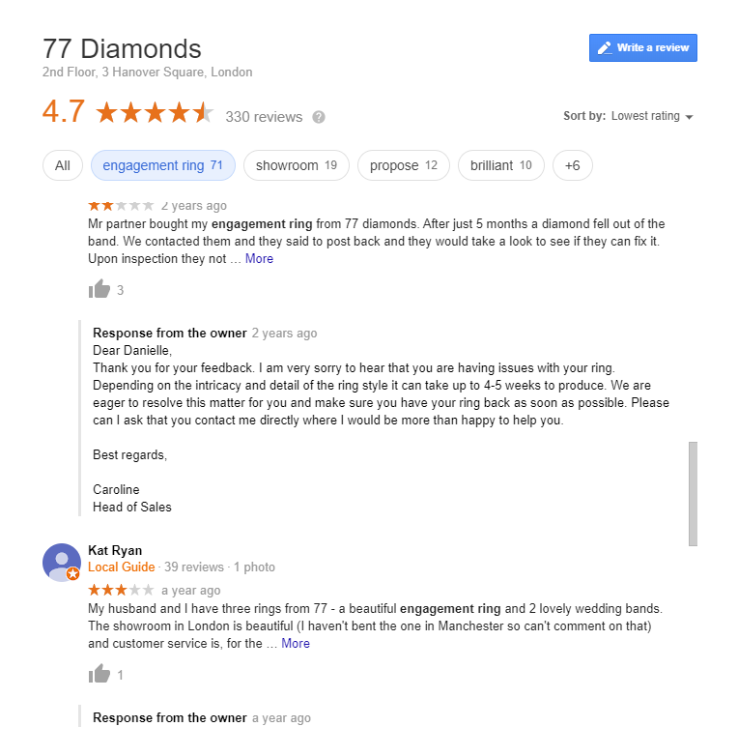
Responding to negative reviews helps even more!
Many businesses shy away from negative reviews, hoping they’ll go unnoticed, or worse, that they’ll end up engaging in a public dispute online.
Negative reviews can happen to anyone, but how you deal with them makes all the difference.
Potential new customers are put off by companies that ignore negative reviews, or worse, respond equally negatively.
Even if you believe the customer to be completely in the wrong, always stay polite, and try respond quickly to provide further details and a clear solution to anyone who may be reading.
Sometimes it can be better to give them a customer service email or phone number to try to resolve their issue, and to take the conversation away from the reviews section.
A bad review can be an opportunity to show you care about your customers.
Get reviews on Google.

Slide 14
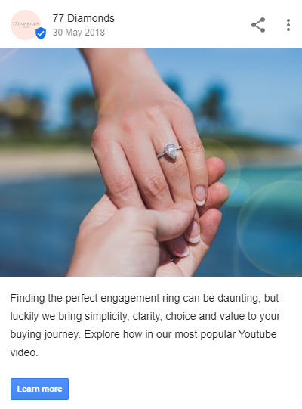
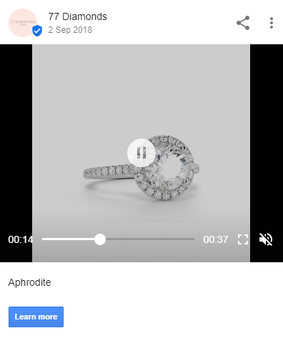
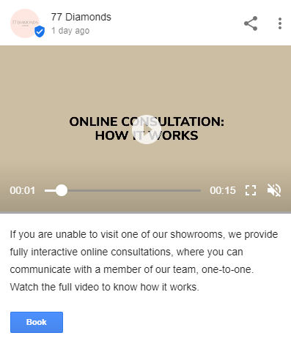
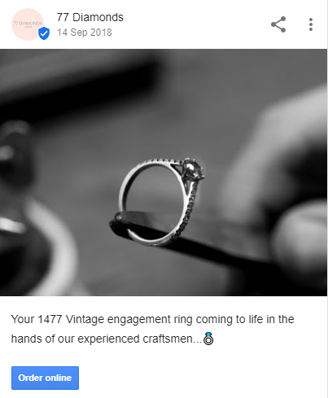
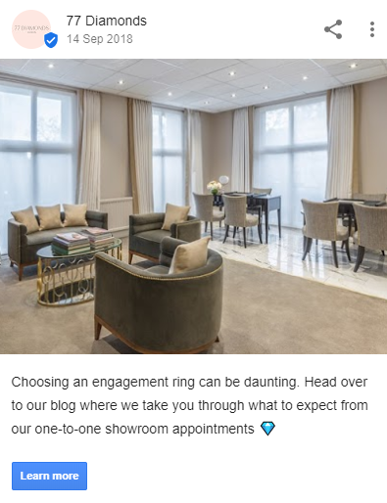
“70% of people look at multiple businesses before making a final choice. With Posts, you can share timely, relevant updates right on Google Search and maps to help your business stand out to potential customers. And by including custom call-to-actions directly on your business listing, you can choose how to connect with your customers.”
Use posts to promote
Google Posts allow you to display promotional content right on your brand search result, and it’s completely free.
You should treat it as another marketing channel, sharing the same content you would on social media or emails, such as:
Blog articles
Company news
eBook downloads
Upcoming events
Special offers
Product promotions
More information on Google posts

Slide 15
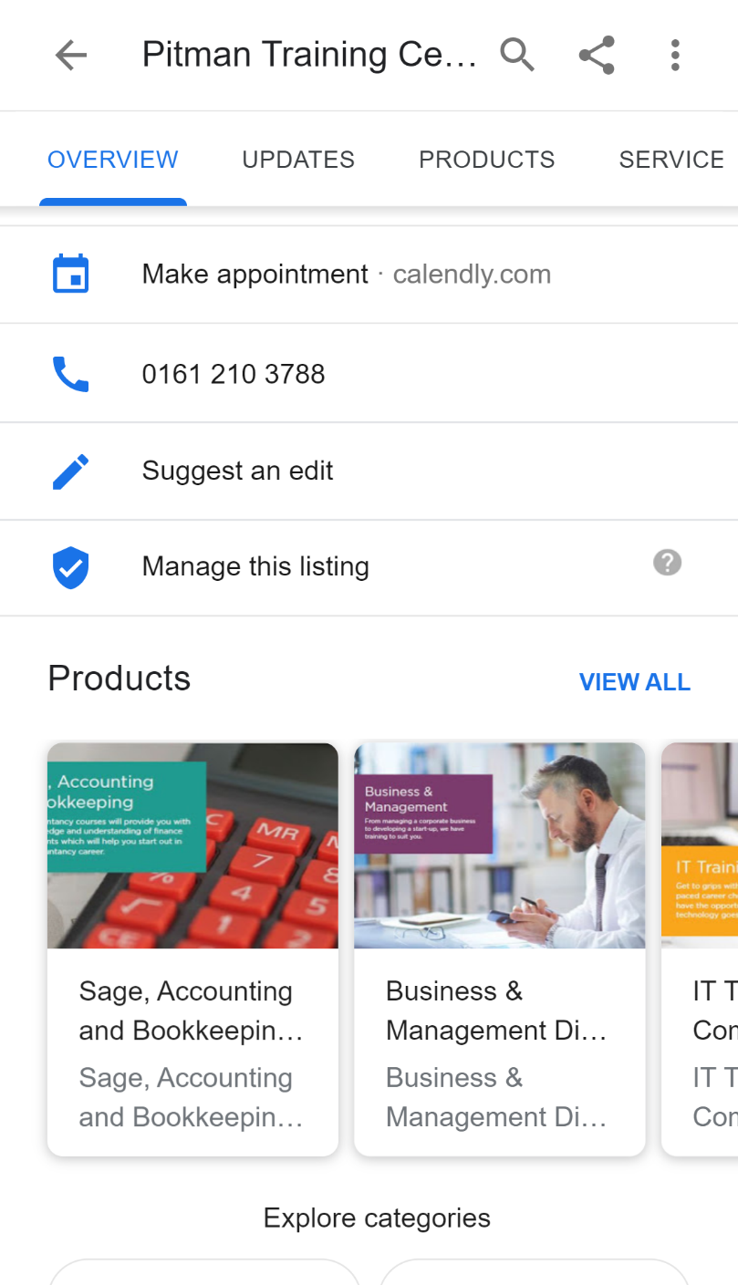
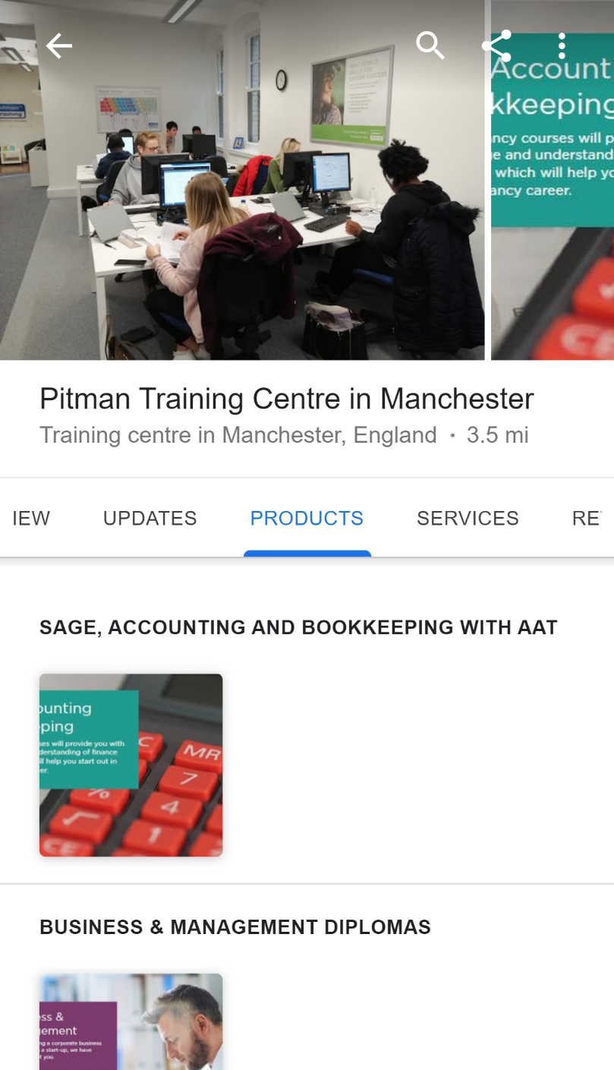
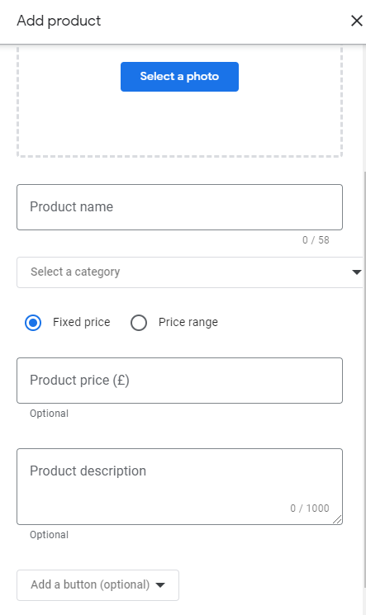
Utilise Products
A
B
C
The Products option is a way to add more information about the items or services you offer as a business.
Products is still in beta and is not available for all listings, but it is a great way to showcase your products on page-one of Google, for free, within your Google My Business Knowledge Panel.
Products appear on your overview (A) & in the Products tab (B), both on desktop and mobile.
The following fields (C) are available: name, photo, price (fixed or range), and description. A call-to-action button (Order Online, Buy, Learn More, Get Offer) with a link is also optional.
Products do not expire.

Slide 16
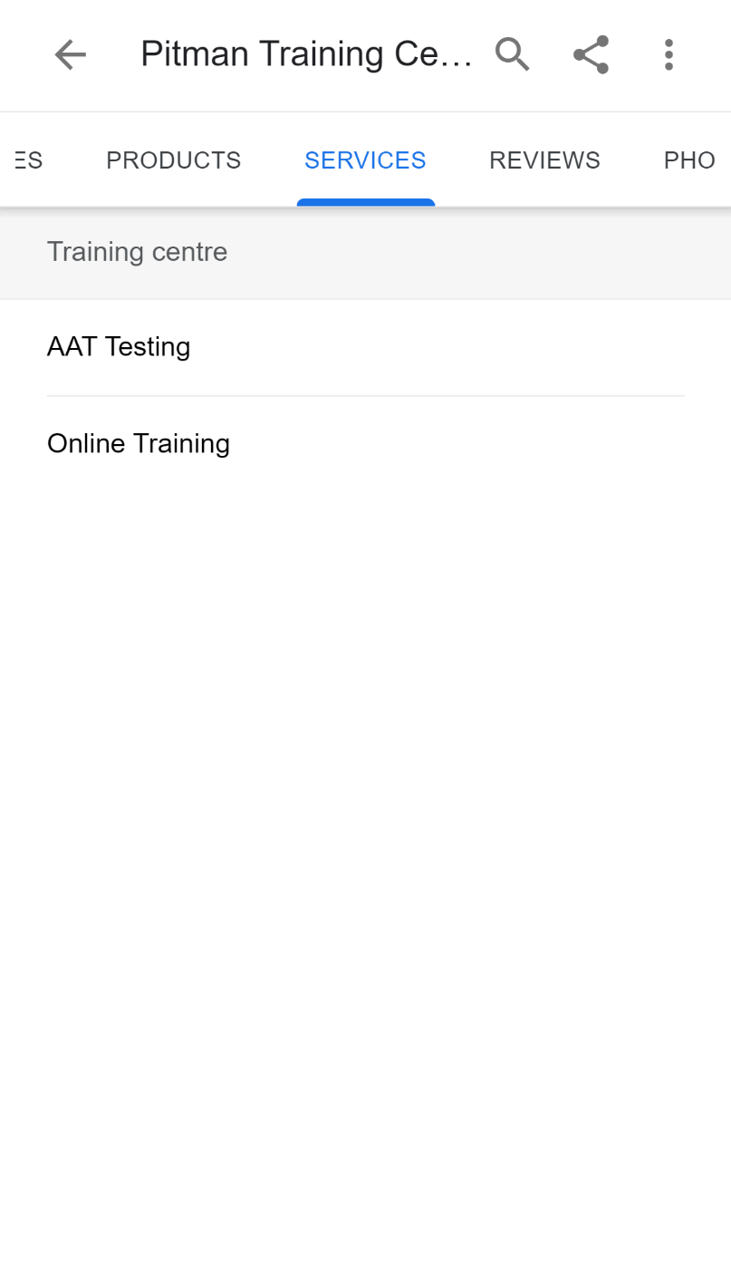
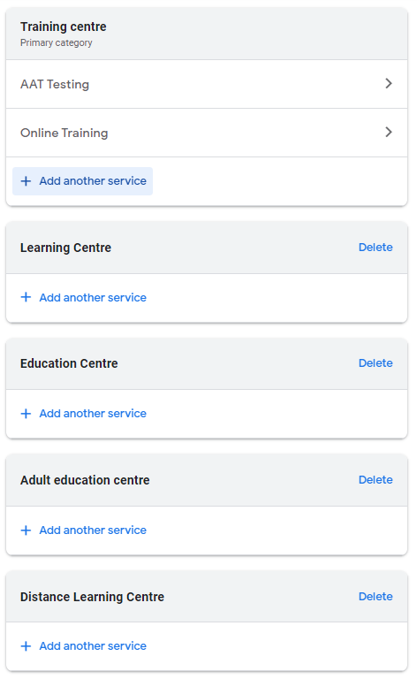
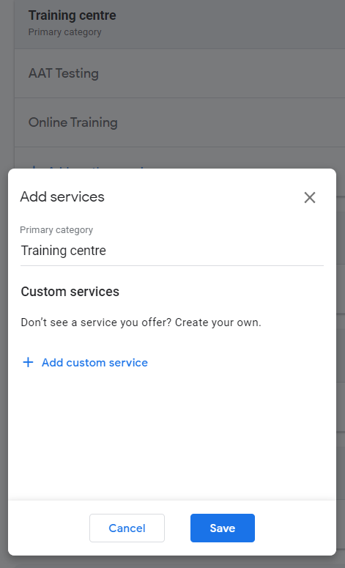
Utilise Services
A
B
C
Unlike the Products feature, Services is fully rolled out and functional. However, their availability is dependent on the categories selected for your Google My Business listing.
While Services are less prominent than the Products feature on the live listings, and are only displayed on mobile (A), they are still helpful in your overall Google My Business optimization efforts.
The categories (B) selected for your business listing are one of the known local ranking factors Google uses to decide when to display your listing in search and on maps, so it assumed that Services are another way for Google to learn what your business does.
If the service you offer isn’t there, you can add it yourself (C).

Slide 17
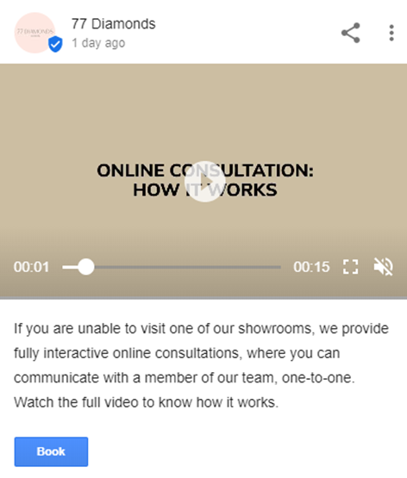
Upload videos
There is no better way to attract, engage, and communicate with your buyers than through video.
If your business isn’t already leveraging it, you’d better get filming.
And once you’ve got some marketing videos to share, why not upload a few to your Google My Business page?
With Google My Business, there are two ways to promote video:
Upload to your Photos (once you click the “upload” button, it’ll ask if you want to upload photos or videos)
Upload Videos as a Post
Click here for further instructions on how to add Videos to your business listing.

Slide 18
Managing Access & Location Groups

Slide 19
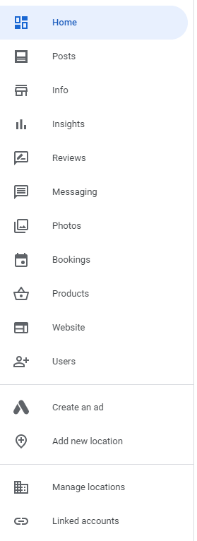
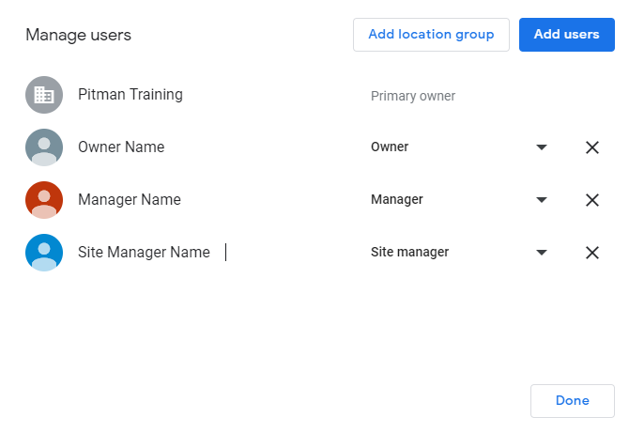
Add owners and managers to share responsibility
Running a business is hard work, and you may not have time to keep your online presence as fresh as you’d like. Owners and managers can help.
By adding owners and managers to your Google My Business listing, you can delegate responsibility to other members of your staff while keeping ownership of the page.
When in your listing, simply click ‘Users’ in the left hand menu, and the little add users button to then add more people.
You can remove owners and managers at any time.
N.B. The people added here will receive notifications about this listing by email.
Learn more about owners and managers.

Slide 20
There are 3 kinds of GMB users
Owners have the widest set of privileges and access, and can make high-level administrative decisions like adding other owners and managers or removing the listing from their account.
Managers can do most of what an owner can do, like edit business information, manage Hangouts (which let you hold video calls with customers), and view Insights about how many people are viewing and interacting with your listing. You might make a trusted staff member a manager of your listing to help keep your information and web presence up-to-date.
Site managers can interact with customers on behalf of your listing by posting pictures and responding to reviews. Friendly, tech-savvy members of your staff might make good site managers.

Slide 21
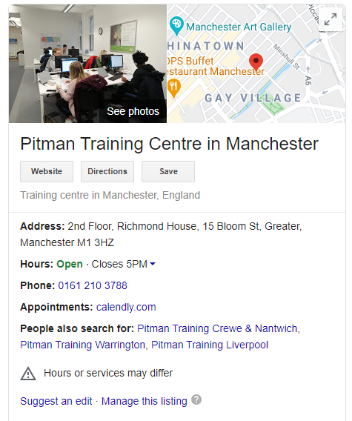
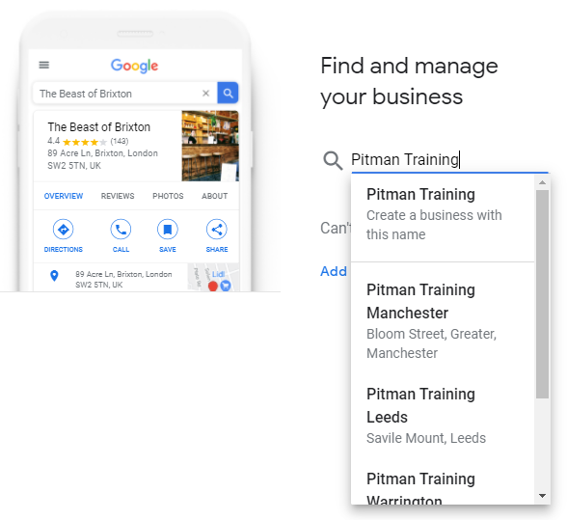
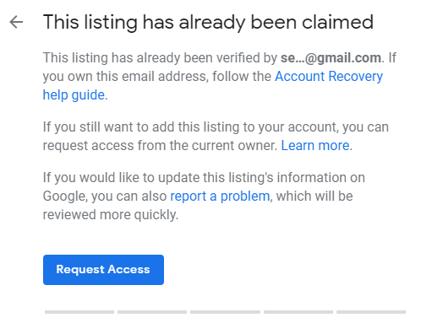
Requesting Ownership
If you come across a business listing which you don’t currently control from your usual email/account, you can request ownership/control.
Sometimes this can be done by clicking a ‘Manage this listing’ link in the knowledge panel.
Or, you can visit https://business.google.com/create and:
Simply enter the name and address of the business
Under the business profile, click claim business
If the listing is not already controlled by another account, the business profile will appear in your GMB locations list and you will be notified by email.
If the listing has already been claimed, follow the instructions via the ‘Request Access’ button.
There are step by step instruction on the Google My Business Help guide on how to do this.
A
A
B
B
C
C

Slide 22
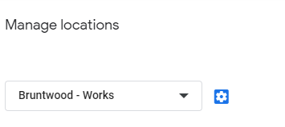
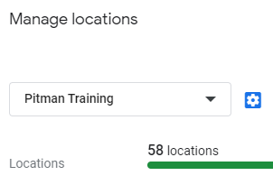
Managing location groups
1
A location group is simply a group of GMB listings that's collectively managed by an organisation or user group.
Sorting your locations into groups makes it easier to manage multiple locations and keep them organised. It enables you to apply changes and share access to multiple listings at once.
In the top-level of GMB, click ‘Manage locations’ in the left menu (1), and then you’ll see the Location Groups drop-down picker (2).
Select a group, then click the blue cog icon next to it to edit the Managers & Owners at a group level.
For more information on managing, creating and transferring location groups go to the Google My Business Help Centre.
2

Slide 23
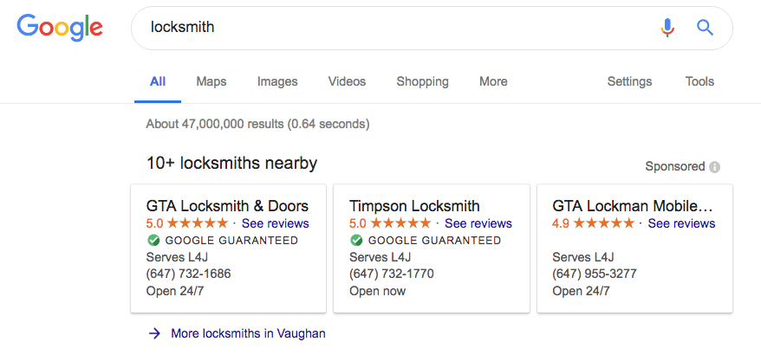
The Google Guarantee
The Google Guarantee badge ✅ is available for businesses that pass a Google screening and qualification process through Google Local Services.
This comes as a $50 per month subscription fee, available in the US and Canada but could be rolled out in the UK soon.
What it covers
The Google Guarantee covers claims up to the amount on the job invoice up to the lifetime cap for coverage.
Services must be booked through Google Local Services. The Google Guarantee doesn’t cover add-on or future projects, damages to property, dissatisfaction with price or provider responsiveness, or cancellations.
Find out more information about the Google Guarantee badge here.

Slide 24
Any questions?

Slide 25
Thank You
Daniel Ward – SEO Executive
Shamima Begum – SEO Executive

